Slide 1
Sciome – VLA Website/Server Needs
Alison Motsinger-Reif : Xiaoran Tong : John House : Sciome

Slide 2
Background – Variance Loci Analysis developed by Xiaoran
Primarily – Variance Analysis of Genetic Variants is to conduct a genome wide scan of variants that are more likely (candidates) for Gene X Environmental effects.
Much work has shown that loci with increased variance across genotype for a given trait are more likely to also be influenceable by Environment
Builds on Variance QTL analysis but with new method for Binary Traits that was previously intractable since the variance QTL for a binomial trait is the same as mean analysis or traditional GWAS
Publishing methodology and want to put results into a database
genelist.niehs.nih.gov
Would like to have done by October and ASHG
At the least -> splash page with query to download most important, for ASHG (Oct 18) and can pretty up our own displays/graphs etc….

Slide 3
VLA Validation and Assessment in UKBiobank on up to 500,000 individuals (trait dependent)
~3300 Traits. (1860 = Dichotomous)
~12m Variants
~4 Races
Conducted
Traditional GWAS
Variant QTL analysis
New Variant Loci Analysis

Slide 4
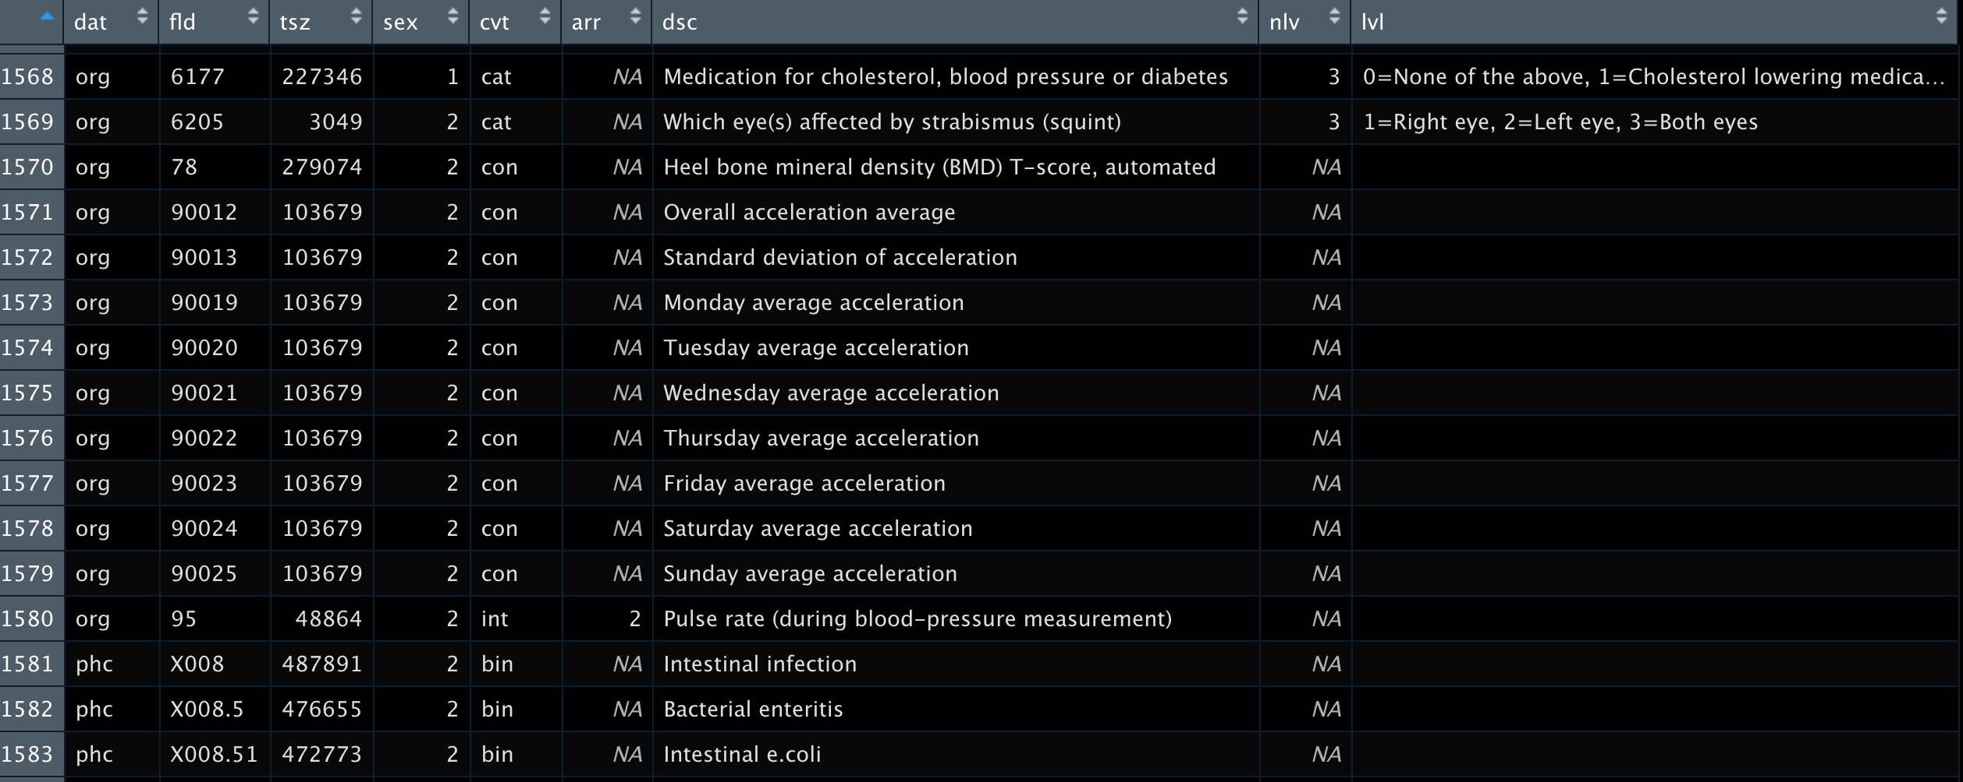
PHECodes as well for outcomes

Slide 5
Data Needs
Meta Data File – Small
~3,300 tar archives by race so ~13,000 files in total
For dichotomous traits – 1 file in each archive ~200Mb in gz(tar) format
Unpacked entirely ~ 1GB each
For traits with more than one level, there may be multiple files
Each file has ~12m rows (variant by pos:chr grchr37) by 10 columns or so
So completely uncompressed ~ 15TB (1gb x 3600 levels x 4 races)
This can be somewhat reduced in principle, since every file has the same variants in the same order

Slide 6
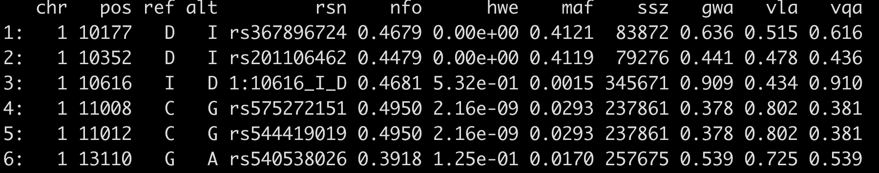
Main Structure – 11,841,785 x 12
For a Given:
Trait_Race_Group
Nfo = UKB information score higher = more reliable
Maf = differs by race, but same by phenotype (as in, this is from ukbiobank, not self derived?)
Ssz is very trait/race specific and would be retained
Gwa – gwas pvals
Vla – “”
Vqa – “”
AS:IS - ~280 MB as .Rdata file (which = gz compression)

Slide 7
Abbreviated 11,841,785 x 9 4 meta files to prepend by genetic ancestry
2 more columns of chr and pos
For a Given:
Trait_Ancestry
Chr19/pos19/chr38/pos38/ref/alt/rsn/hwe are always the same by Ancestry
If we only keep the last 5 columns and name file with fld_level if level exists (which is static),
File reduced to ~ 140MB – would just prepend first 5 columns
This produces total data set in gz compression ~ 2.4TB
0.165GB x 3600 x 4)

Slide 8
Query types
Select multiple traits and get either
Flat files with XXX number of smallest VLA p-values
Or just a query that returns all pvalues < a –log10 value
Compressed Flat files with all 12m rows archived for a given trait and race
Keep in Mind while designing –
Primary purpose envisioned is to provide a candidate list of variants for an investigator to use in a GxE analysis of their own
If we can say these XXX variants are a good place to start and serve those up based on selection criteria (top XXXX by pval etc…)

Slide 9
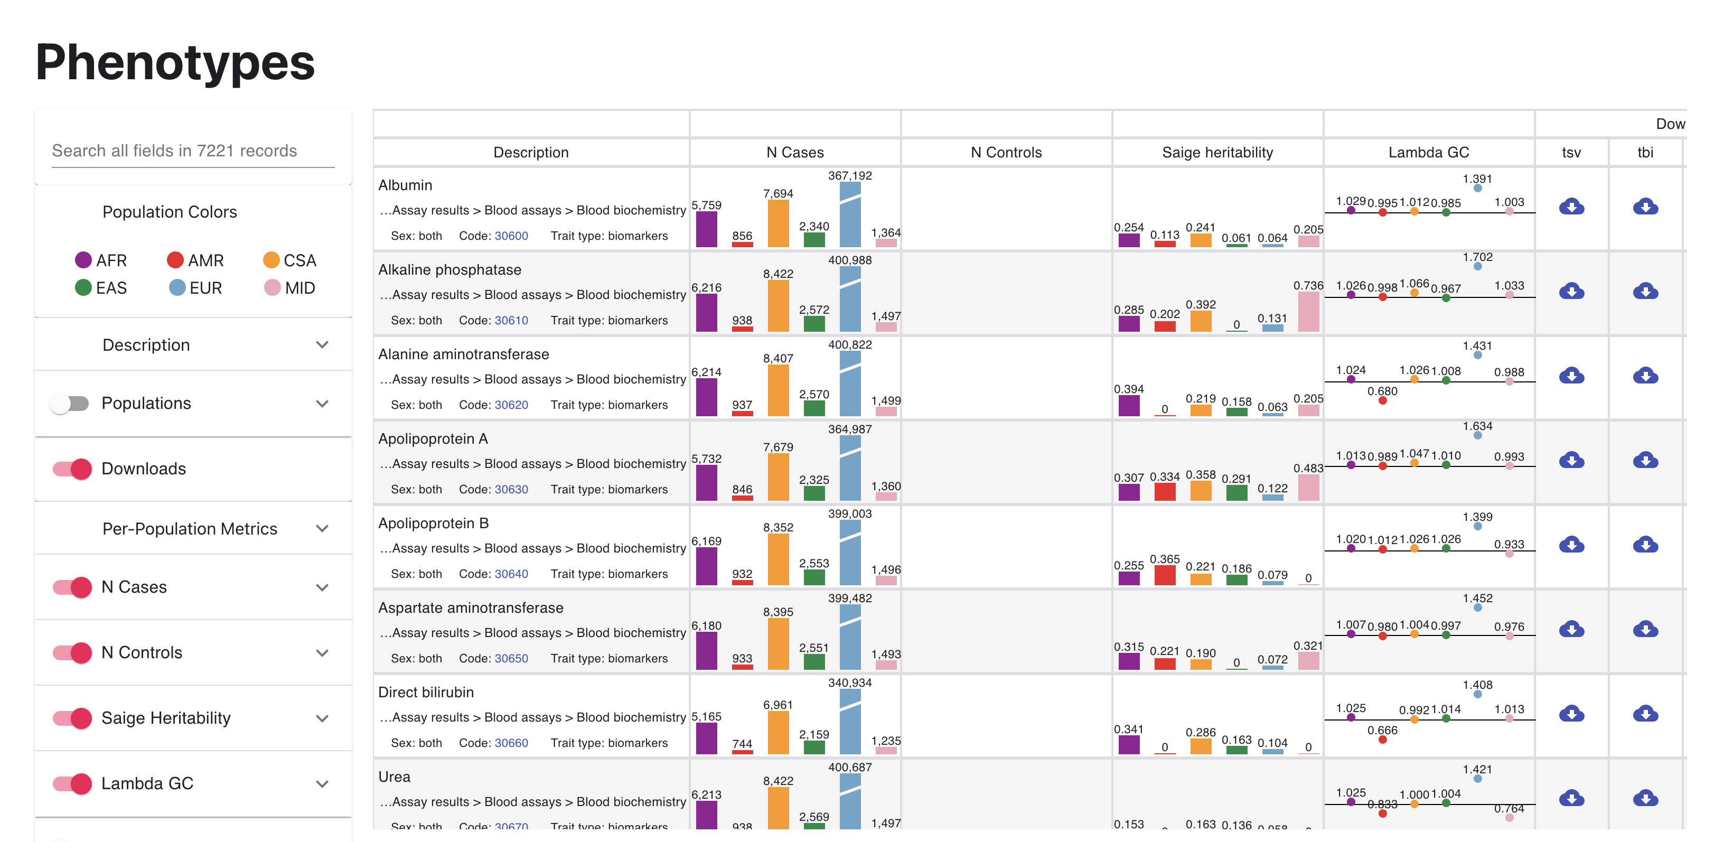
Website Thoughts and Designs – Examples https://pan.ukbb.broadinstitute.org/phenotypes

Slide 10
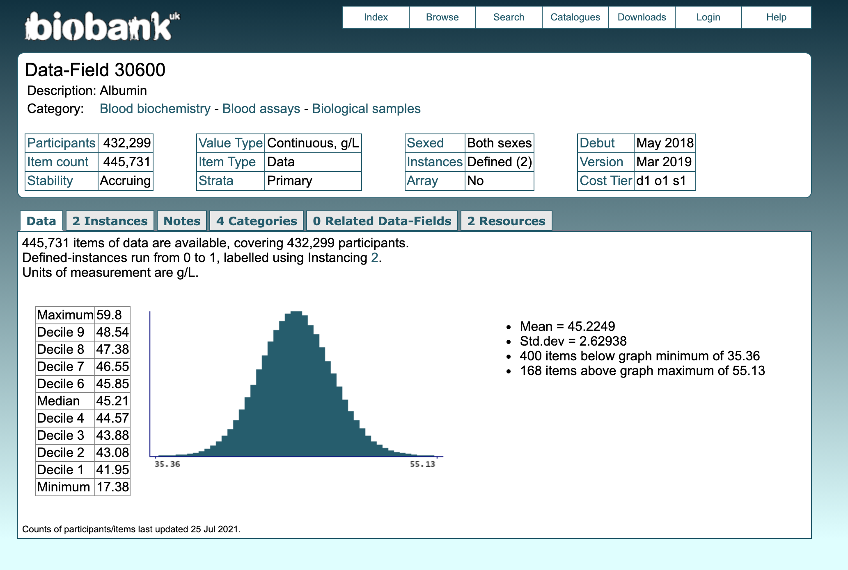
Each Trait has UKBIOBank field code Link to it. Our files are named by the field code – 30600 in this case

Slide 11
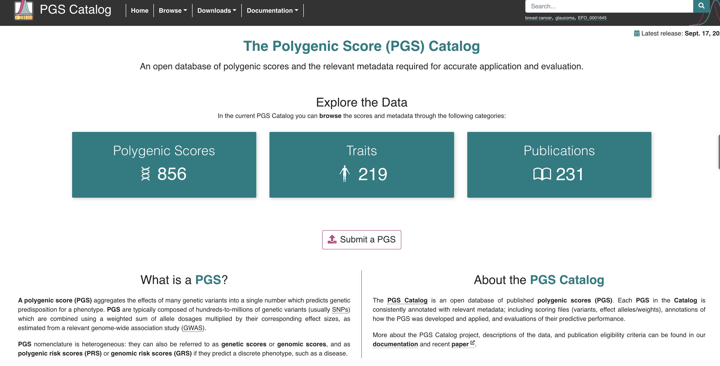
Website Thoughts and Designs – Examples https://www.pgscatalog.org/

Slide 12
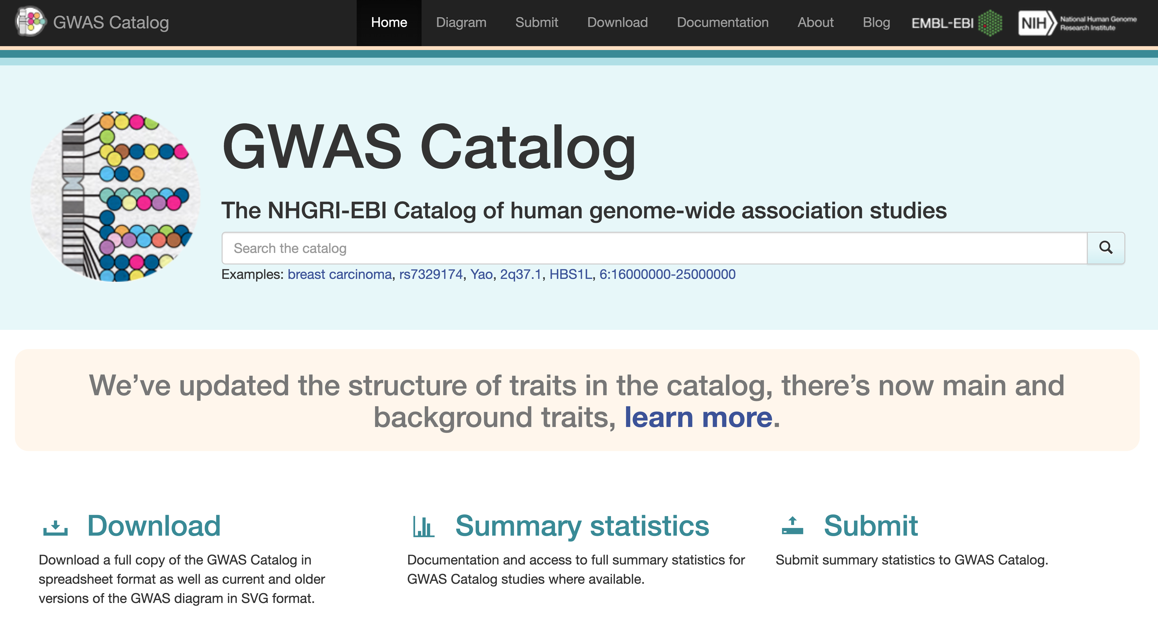
Website Thoughts and Designs – Examples https://www.ebi.ac.uk/gwas/

Slide 13
Summary Graphs and more Query thoughts
Allow to pull based on ukbiobank hierarchy – ALL CVD traits for example
Also allow alternate pull by PHEcoding that has been mapped to the field codes
Static MH Plots of –log10(pvals) with genomic inflation values
Summary Meta Data by pvalue type and trait
Outcome type (binary, cont, categorical etc…)
If categorical, what was referent for each sub analysis
Number of variants with pvalues < some cutoff
Maybe some kind of circos plot of 3 tracks = each of the –log10pvals with chromosomes blocked off on the circle. A multicolored mahattan plot would work but also get busy with 3 colors
When you select a given trait to see if you want it, this info would be great to see,
Eventually some kind of enrichment by CHR location or PW types?
NOTE – VQA and Biniary Traits – Data exist but do not show or query

Slide 14
Red Tape and Admin stuff
NIH website requirements
Would prefer to have tabbed pages at top and not left sidebar
Splash page
Details – Background GWA/VLA/VQA -- UkBiobank
Pretty Graph page based on slide 6 with links out to UKB
Query data download page – build query
Will need to think about how many traits to allow
Will need to think about special request process if they want all data?
Branding – Color Schemes, Icon (s)? Etc.. Mandatory NIEHS sidebar but not menu driven
Lastly, we will probably triple data when we stratify by sex
Overall – exists
Males
Females

