Slide 1
Figures in Main-Text

Slide 2
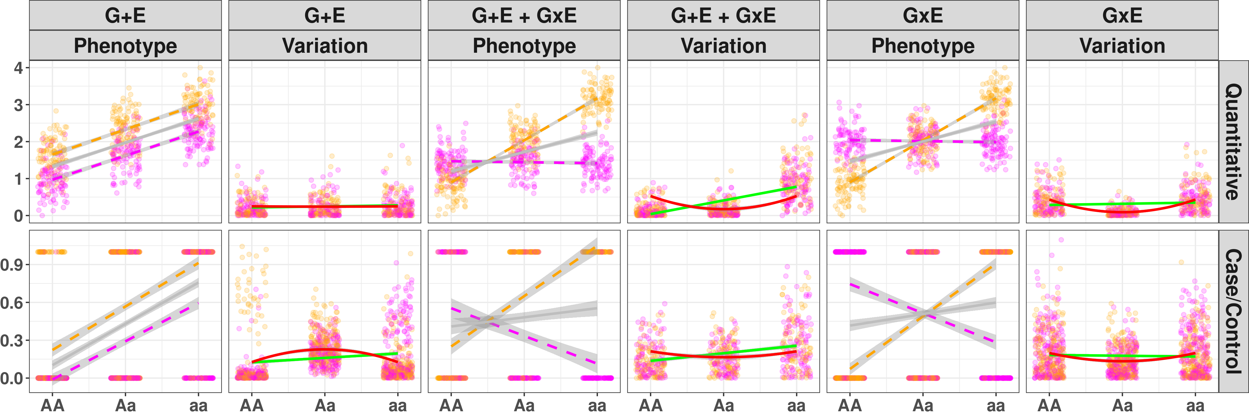
(a)
(c)
(e)
(b)
(d)
(f)
Figure 1: Illustration of Variance Loci suggesting GxE candidate variants.
Gray line: regression lines across phenotypic mean, fitted by GWAS without considering environment information; green line: regression lines fitted by double linear model (DLM) for a non-zero slop test; solid red line: 2nd-order polynomial curves fitted by variance loci analysis (VLA) for a positive gradient test; magenta/orange: environment-specific observations; x-axis: genotype as counts of allele “a”; y-axis: either phenotype values, or variations around the mean. (a)(b): variant (G) and environment (E) effects exist with null GxE; (c)(d): variant (G), environment (E), and GxE effects all exist; (e)(f): variant (G) and pure GxE effects exist with null environment effect.
Row 1 (a, c, e): quantitative phenotypes. (a) In the absence of a GxE (G+E), the phenotype varies uniformly across the genotype, and a flat line fits through the variation, therefore DLM and VLA maintain that A/a is not a variance loci, but GWAS significance erroneously suggests A/a as a GxE candidate; (c) In the presence of GxE, the phenotype spreads unevenly across genotypes, a line with non-zero slop (solid green) and a curve with positive gradient (solid red) fit through the variation, therefore, DLM and VLA recognize A/a as a variance loci and GxE candidate; (e) In the case of a pure GxE, a flat line fit through the variation (solid green line) so DLM could not recognize the variance loci, but a curve with positive gradient (solid red) still fits through, allowing VLA to detect the variance loci.
Row 2 (b, d, f): case/control phenotype. (b) Even in the absence of a GxE, a non-zero slope still fits through the variation (solid green). Therefore, DLM wrongfully classifies A/a as a GxE candidate, inflating type 1 error, but VLA’s positive gradient test does not because the curve fit through the variation had negative gradient (solid red); (d) in the presence of GxE, VLA’s positive gradient test can detect A/a as a GxE candidate (solid red line); (f) VLA positive gradient test also detects pure GxE candidate (solid red) where DLM non-zero slop test fails (solid green).

Slide 3
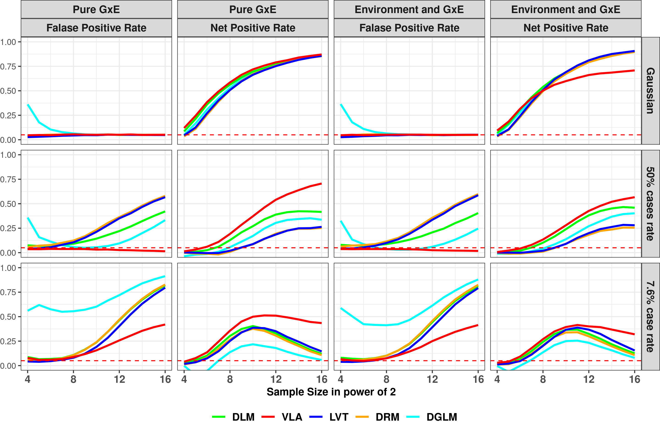
Figure 2: False Positive and Net Positive rates of 20,000 Simulations
Each sub-figure display positive rates of various putative GxE variant tests (denoted by colors), that is, out of 20,000 simulations, how often a test rejected H₀: the variant in question is not a GxE candidate. 1st column: environment main effect and GxE are both null, the y-axis shows the false positive rate (FPR) since rejecting H₀ wrongfully classify the variant as putative GxE candidate; 2nd column: there was no environment main effect but a pure GxE effect, the y-axis shows net positive rate (NPR) as true positive rate – false positive rate in the 1st column; 3rd column: environment main effect exists without GxE, the y-axis again shows false positive rate; 4th column: both effects exists, the y-axis again shows net positive rate as true positive rate – false positive rate in the 3rd column. In the absence of GxE, a false positive rate of 0.05 (denoted by horizontal red dashes) is considered proper, higher suggests over confidence, lower suggests overly conservative. In the presence of GxE, a higher net positive rate mean the corresponding putative GxE test is more efficient in selecting GxE candidate variant.
The three rows separate the type of phenotype simulated: Gaussian (top), balance case/control (middle), and imbalanced case/control (bottom).
Solid line in color denotes the type of putative GxE tests: DLM - double linear Model, VLA - variance loci analysis with proposed positive gradient test, LVT - Levene’s robust test of heterogeneous variance, DRM - deviation regression model test, and DGLM - double generalized linear model.

Slide 4
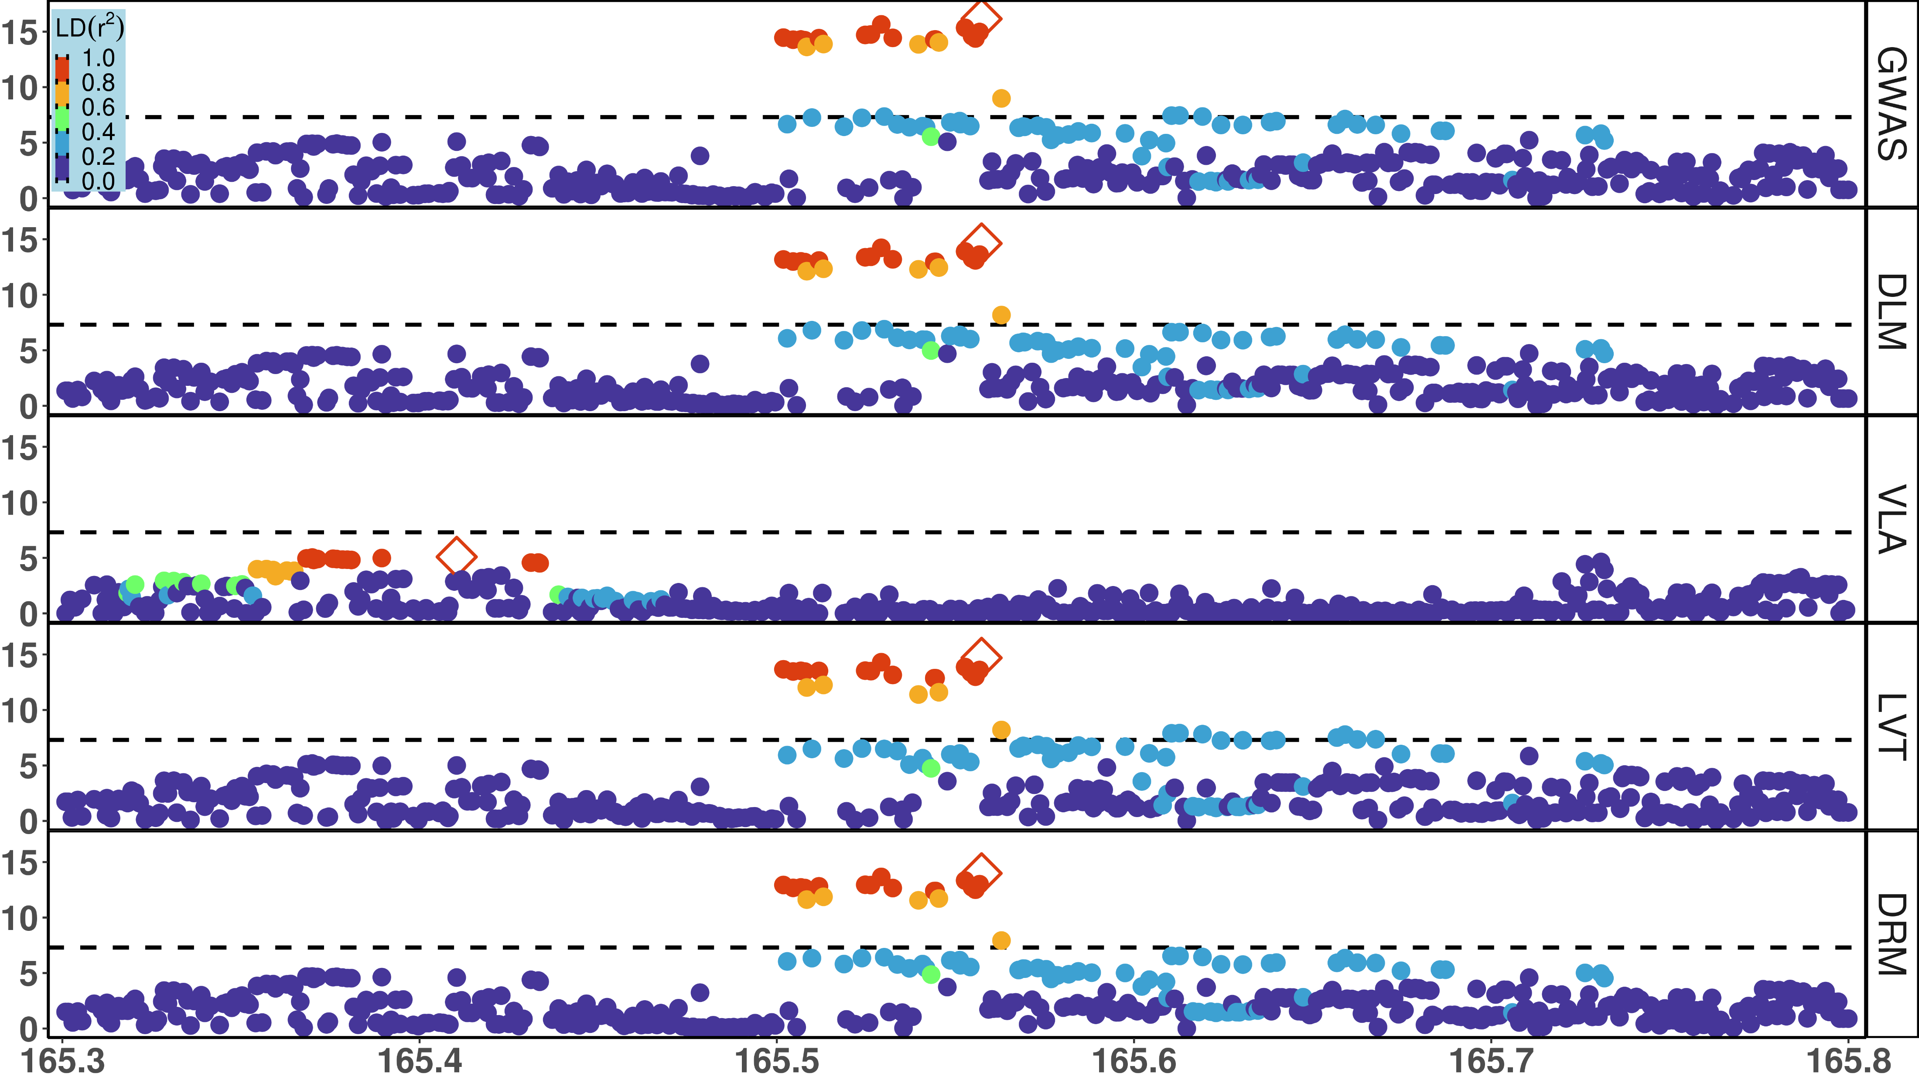
Notes:
Figure 3b: Local Manhattan Plot for T2D
x-axis: basepairs on chromosome 2; y-axis: -log₁₀(p); dash: significance threshold -log₁₀(5e-8); each point stands for a few dozen variants in a bin, represented by the most significant one.
Rows: 5 putative GxE test, GWAS = genome wide association study, DLM = double linear model, VLA = variance loci analysis (order-2 polynomial positive gradient test), LVT = Levene’s robust test, DRM = Deviation Regression Model; Color: denote LD between the top hit (diamond) and rest of the variants; red means high LD, blue means low LD.
Note for US:
binning of variants thin the number of points for a better presentation.
This local plot present the region marked by red circles in the full plot (the thumbnail to the right, or previous page); the thumbnail is optional.
The top hit for VLA is different (to the left) from the other 4 tests (in the middle, around rs6712203).

Slide 5
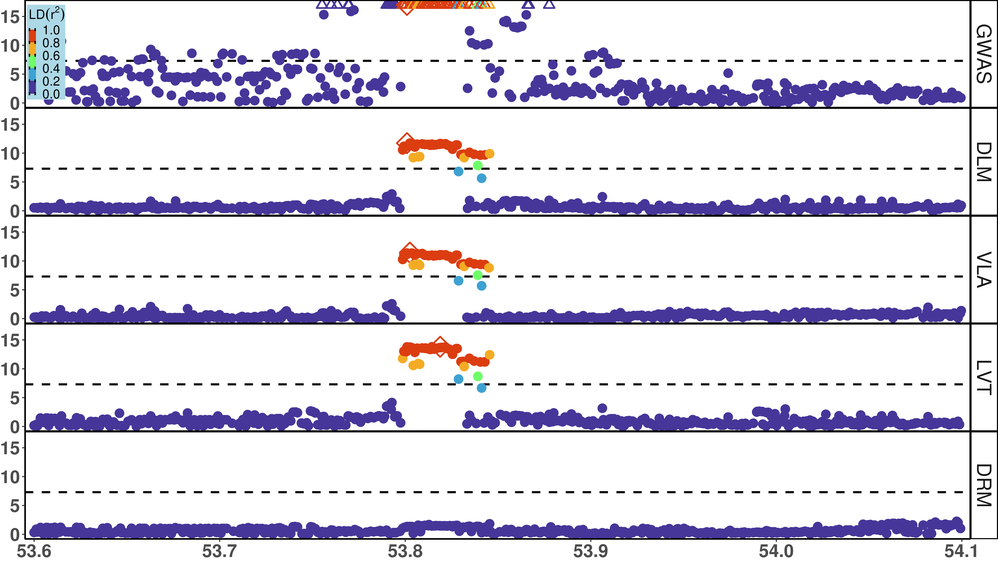
Notes:
Figure 3b: Local Manhattan Plot for T2D
x-axis: chromosome 16; y-axis: -log₁₀(p); dash: significance threshold -log₁₀(5e-8); each point stands for a few dozen variants in a bin, represented by the most significant one.
Rows: 5 putative GxE test, GWAS = genome wide association study, DLM = double linear model, VLA = variance loci analysis (order-2 polynomial positive gradient test), LVT = Levene’s robust test, DRM = Deviation Regression Model; Color: denote LD between the top hit (diamond) and rest of the variants; red means high LD, blue means low LD.
Note for US:
binning of variants thin the number of points for a better presentation.
This local plot present the region marked by red circles in the full plot (the thumbnail to the right, or previous page); the thumbnail is optional.
The top hit for VLA is different (to the left) from the other 4 tests (in the middle, around rs6712203).

Slide 6
(a)
(c)
(e)
(b)
(d)
(f)
Figure 4: Empirical GxE and Functional Enrichment Analysis
top: results for body mass index (BMI); bottom: results for type 2 diabetes (T2D); (a)(b)(c)(d): GxE enrichment analysis, x-axis denotes the empirical GxE significance scored by the number of p-values below a threshold, or by the sum of negative log p-values, across all exposures considered; a higher bar means a putative GxE variant selection test (denoted by color) is superior; (e)(f): functional enrichment analysis, x-axis denotes variant class labels and CADD score (combined annotation dependent depletion), in this case, a higher bar mean a putative GxE selection test tend to emphasize variants of certain class or higher CADD.

Slide 7
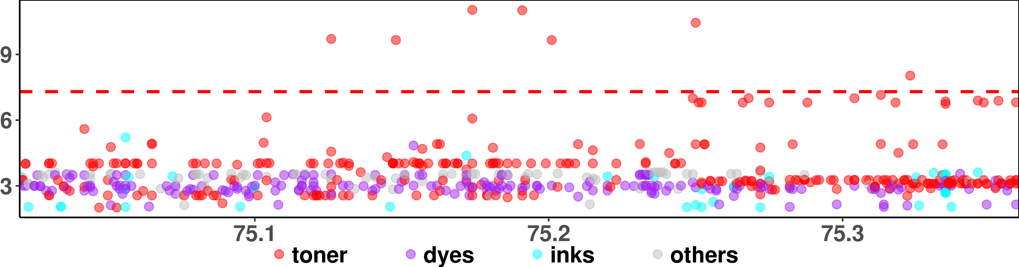
CHR X: (LD score & ideogram)
q13.3
rs4409555
Genes:
<ABCB7
UPRT>
q13.3 (MB):
Figure 5: GxE interaction between SNPs in ABCB7-UPRT and print materials associated with T2D in PEGS
The Manhattan plot shows unadjusted -log10(P) (y-axis) for GxE due to SNPs between X: 75,020,000 - 75,360,000 (x-axis) and exposures to print materials (colored points); The gene bars shows ABCB7 and UPRT (rendered by NCBI genome viewer); the ideogram on top shows chromosome X (rendered by UCSC genome browser), the enclosing region q13.3 (red), and LD scores (blue) based on 3104 genotyped females (68.4%) in PEGS; the GxE between SNPs in ABCB7-UPRT and toner (red points) reached beyond conventional genome wide significance (-log10(5e-8), red horizontal dash). Although the smallest p-value (rs4409555, 9.25e-12) did not guarantee significance after Bonferroni correction over 4.74 billion selectable GxE tests, the region was prioritized by significant variance loci found by VLA in the UK Biobank.

