Slide 1
VLA Draw Board
Compile Graphical Material for Publishing

Slide 2
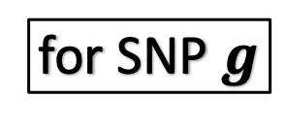
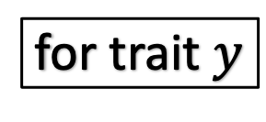
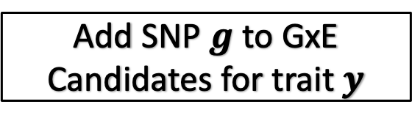
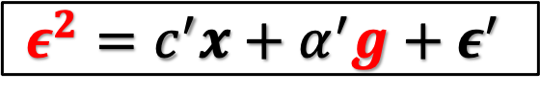
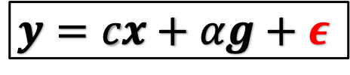
for trait $y$
for SNP $g$
$$y=cx+αg+ε$$
residual
$$ε^{2}=c^{′}x+α^{′}g+ε^{′}$$
next
next
Linear Model 1
Linear Model 2
retain
test h₀:𝛼′=0
reject
Add SNP $g$ to GxE
Candidates for trait $y$
DLM: Double Linear Model

Slide 3
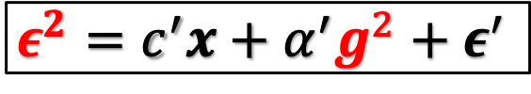
for trait $y$
for SNP $g$
$$y=cx+αg+ε$$
residual
$$ε^{2}=c^{′}x+α^{′}g^{2}+ε^{′}$$
next
next
Linear Model 1
Linear Model 2
retain
test h₀:𝛼′≤0
reject
Add SNP $g$ to GxE
Candidates for trait $y$
VLA: Variance Loci Analysis

Slide 4
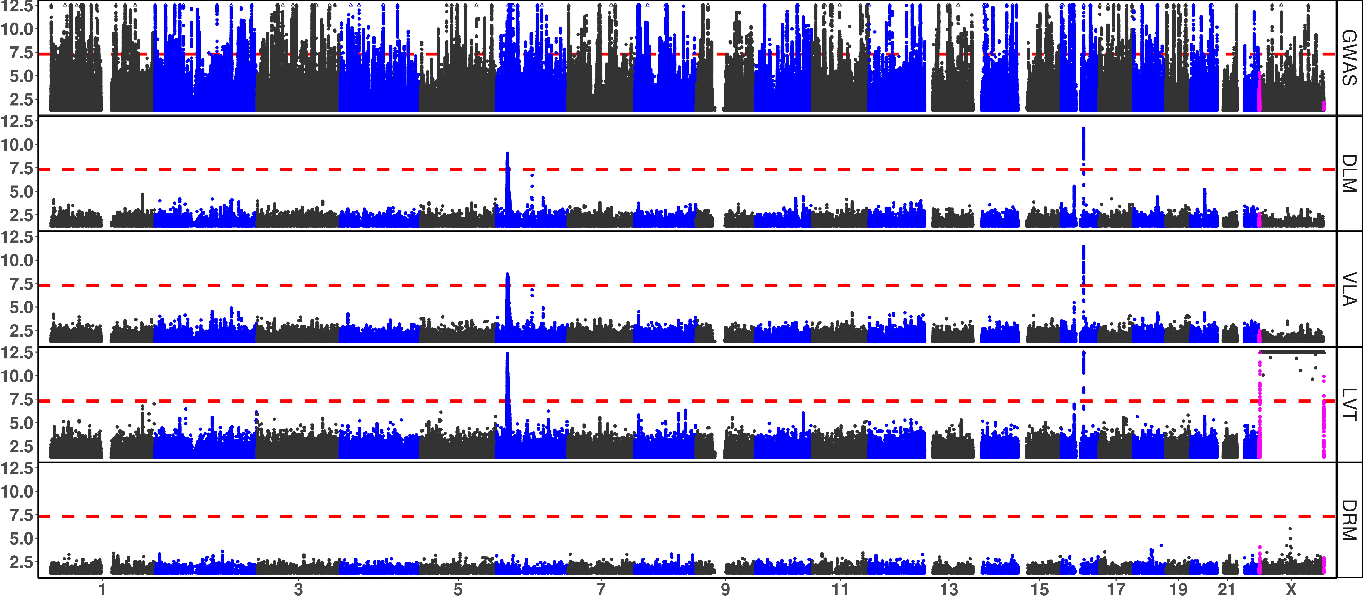
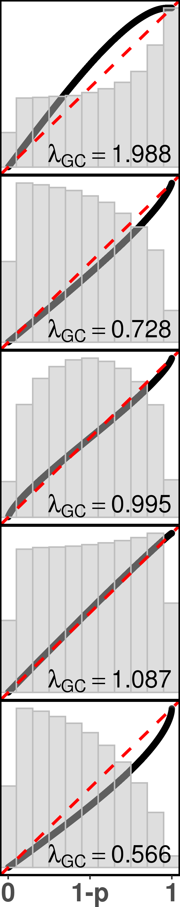
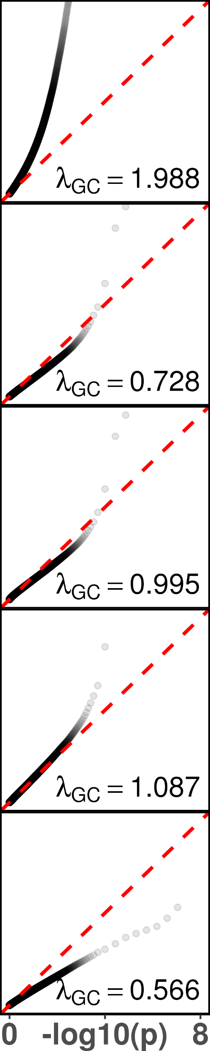
Body Mass Index

Slide 5
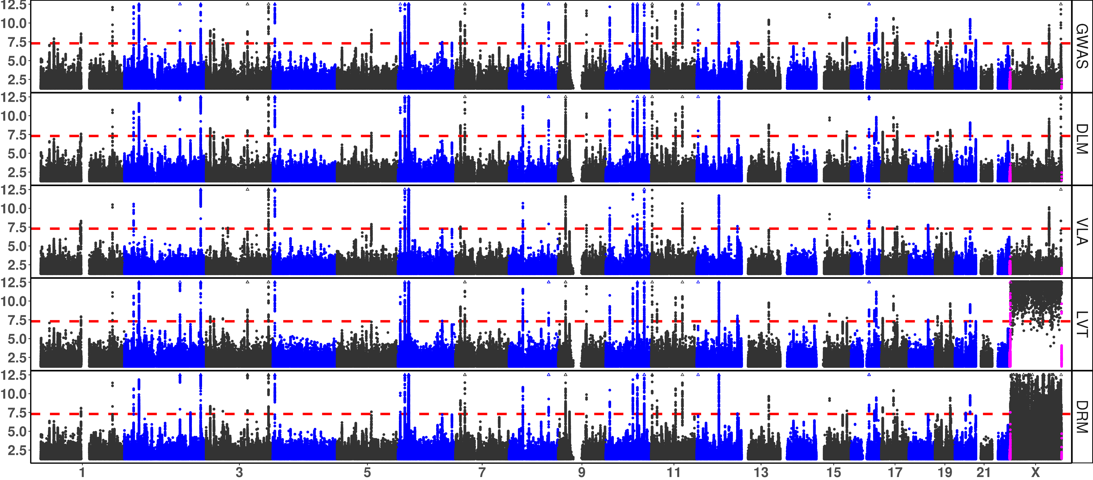
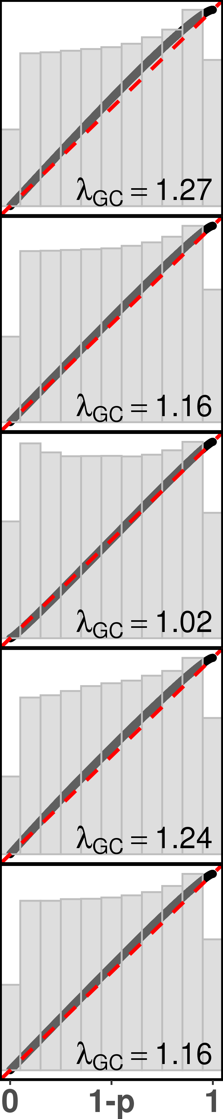
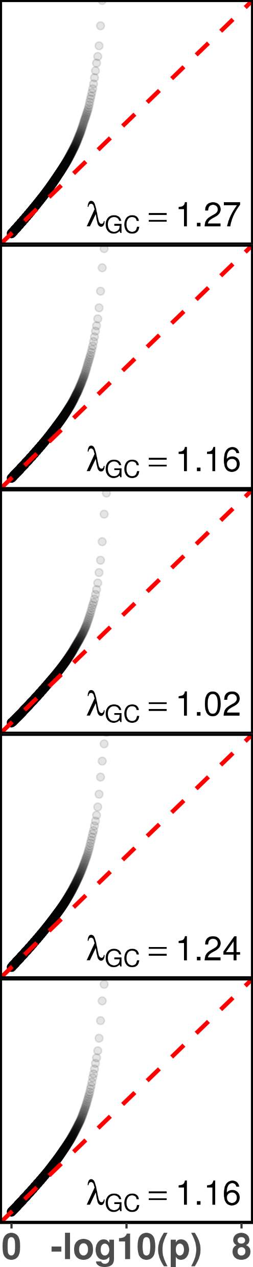
Type 2 Diabetes

Slide 6
Why the QQ plot in –log10(p) looked conservative, but VLA’s lambda GC was close to 1.0? Why DLM’s lambda GC was as low as 0.73, but the two Manhattan plots looked quite like?
- If the QQ plot is made in the original scale, it reveal that the p-values from VLA were overall balanced.
- the magnitude of VLA and DLM test statistics are similar, due to mutual absorption of SNP and SNP^2 when MAF is small (figure 1, two red ovals). however, VLA’s upwardness test is single tailed, and only rejects H₀ at positive significant (assuming phenotypic variance increase with additional alleles).
- as a result, the distribution of VLA’s p-value looks like DLM’s in a mirror (figure 1, green and red ovals, also look at the histograms in the back)
* about half of the time, the two are similar, because the test statistics >0.
* about half of the time, the two are opposite, because the test statistics <0.
* some time, DLM = 0, but VLA > 0, these are pure GxE candidates.
- Upon close inspection,
* for p-values < 0.5, VLA is locally inflated (figure 2, red circle)
* for p-values > 0.5, VLA is locally deflated (figure 2 ,green circle)
* overall, VLA is balanced, that was why the lambda GC was close to 1.
- About the similarity in Manhattan plots
* a Manhattan plot highlights peaks, mostly shared by both DLM and VLA.
* it can not reveal the order of p-value for less and non-significant SNPs
* their massive number obscure themselves in the lower section of Manhattan.
- See the next slide for a similar argument for –log10(p) based QQ-plot.
GWA
Hyper-inflation
DLM
Overall deflation
similar
localized deflation
VLA
balance
Localized inflation
mirror
LVT
DLM
Hyper-deflation

Slide 7

Why the QQ plot in –log10(p) scale were similar between DLM and VLA, both of which looked conservative, but VLA’s lambda GC was apparently close to 1.0?
The –log10 transformation condensed large part of less and insignificant SNPs to the lower left corner of the QQ plot (red circle), the fact that VLA’s p-values were overall more balanced, was obscured by a massive number of overlapping points in this section of the QQ-plot.
The more and highly significant SNPs are locally conservative for VLA (green circle), the –log10 transformation highlighted this part because it stretch out values close to 0, making the QQ plot look like DLM which is overall conservative.
If we respect the fact that VLA’s tests are singled tailed, and translate the p-value back into a z-score accordingly, and treat the squared z-score as chi-square, the “corrected” lambda GC will not be 0.99 but 0.717, which fits the perceived “conservativeness” from the –log10 QQ-plot, but should we use it?
GWA
DLM
condense
Localized deflation
VLA
condense
LVT
DLM

Slide 8
Questions to Ask
After all, VLA does show superior enrichment of GxE detection.
It did not declare as much significance as GWAS and LVT did.
It ensure more of what it captured are truly GxE candidates.
Doesn’t this show that VLA is overall balanced – not inflating much, nor overly conservative To warrant a close to 1.0 lambda GC?
It was the –log10(p) based visualization did not do justice to VLA
Should we consider p-value based QQ-plot?
In one of my publication, I was allowed to use QQ-plots in the original scale.
Should we talk about these issues on Friday?

Slide 9
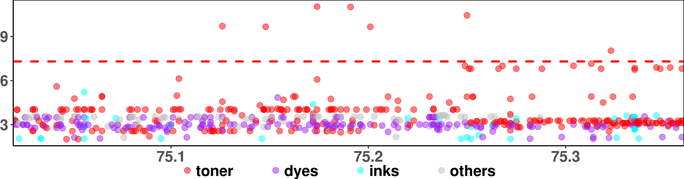
CHR X: (LD score & ideogram)
q13.3
Genes:
<ABCB7
UPRT>
rs4409555
q13.3 (MB):

Slide 10
