Slide 1
Identification of Putative Gene by Environment Variants with Variance Loci Analysis Reveals Unique and Common Pathways and Genes in UKBiobank Disease Outcomes
Violet Evans Motsinger-Reif Research Group National Institute of Environmental Health Sciences Scholars Connect Program Symposium (NSCP)
Notes:
Comparison of Gene by Environment Loci Identification Methods in UKBiobank

Slide 2
Background
Objective: To compare and contrast method results for identifying likely GxE candidate loci in 14 health outcomes using pathway analysis in the UKBiobank
Source Data:
The UKBiobank is a large biomedical database that contains genetic and health information from 500,000+ UK citizens
British white individuals were assessed with three methods for identification of GxE candidate loci from ~12 million variants
Single nucleotide polymorphisms (SNPs) represent a difference in nucleotides

Slide 3
Gene x Environment Interactions
Genetics influences how the same exposure can result in different responses across individuals
Gene x Environment interaction－ trait of interest is affected differently across genotype between exposed and non-exposed individuals
Example－ Skin cancer and sunlight exposure
Notes:
Genetics influences how the same exposure can result in different responses across individuals, whether to a pollutant or drug. For example, both genetics and environmental exposures play a role in the risk of skin cancer. Some genomic variants confer greater risk for developing skin cancer. Likewise, more environmental sunlight exposure also confers increased risk of cancer. An example of a gene x environment interaction would be where individuals with certain genetic variants have increased skin cancer risk compared to those without, for similar sunlight exposures.

Slide 4
Candidate Identification Methods
GWAS (Genome-Wide Association Studies): an established means-based approach to identifying variants associated with phenotype
VQA (Variance Quantitative-Trait-Loci Analysis): an established method for identifying candidate loci based on non-constant variance across phenotype by genotype
VLA (Variance Loci Analysis): a novel variance-based approach created by Xiaoran Tong, PhD. (NIEHS), applicable to binary outcomes

Slide 5
Methods- Continued.
Candidate variants mapped to the nearest gene
Conducted Pathway Analysis
MsigdbC2CPAll ontology set, a curation from online pathway databases and biomedical literature
Representing specific well-defined biological states of processes
Assessed unique gene and pathway counts across 14 traits using XGR in R- 4.0.5
Used rigorous multiple testing corrections
rs1002656
rs1194949138
MIR4255
rs1640881087
Chromosome 1
Notes:
Single nucleotide polymorphisms, frequently called SNPs (pronounced “snips”), are the most common type of genetic variation among people
Each SNP represents a difference in a single nucleotide
Candidate variants at a FDR of 0.10 were mapped to a nearest gene
That unique gene list was then used for pathway analysis

Slide 6
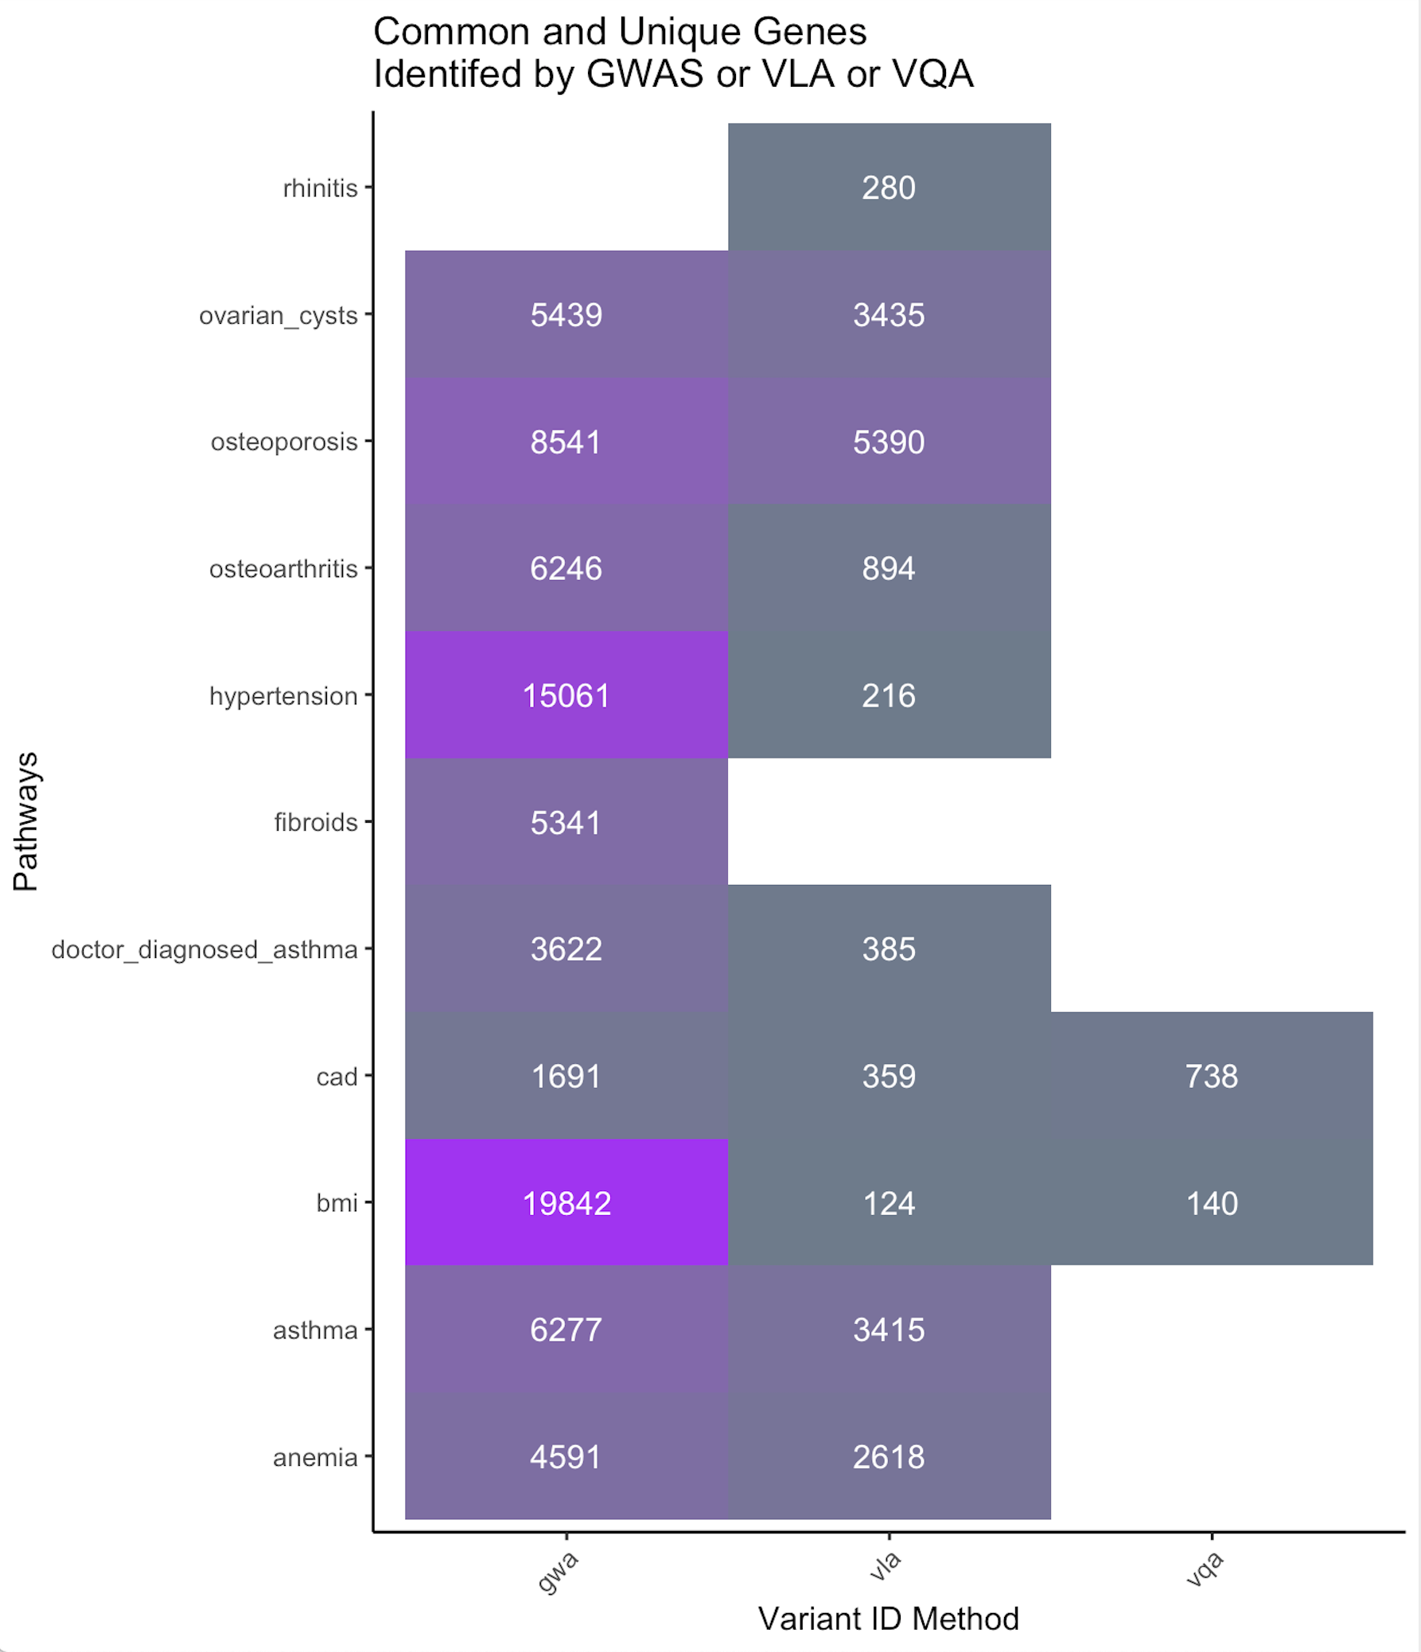
Unique Genes Identified by Method
Total Number of Significant Genes by Method
GWAS: prolific and maps to more unique genes
VQA: works only with continuous traits
VLA: identifies genes in dichotomous traits with more discrimination than GWAS
cv burden

Slide 7
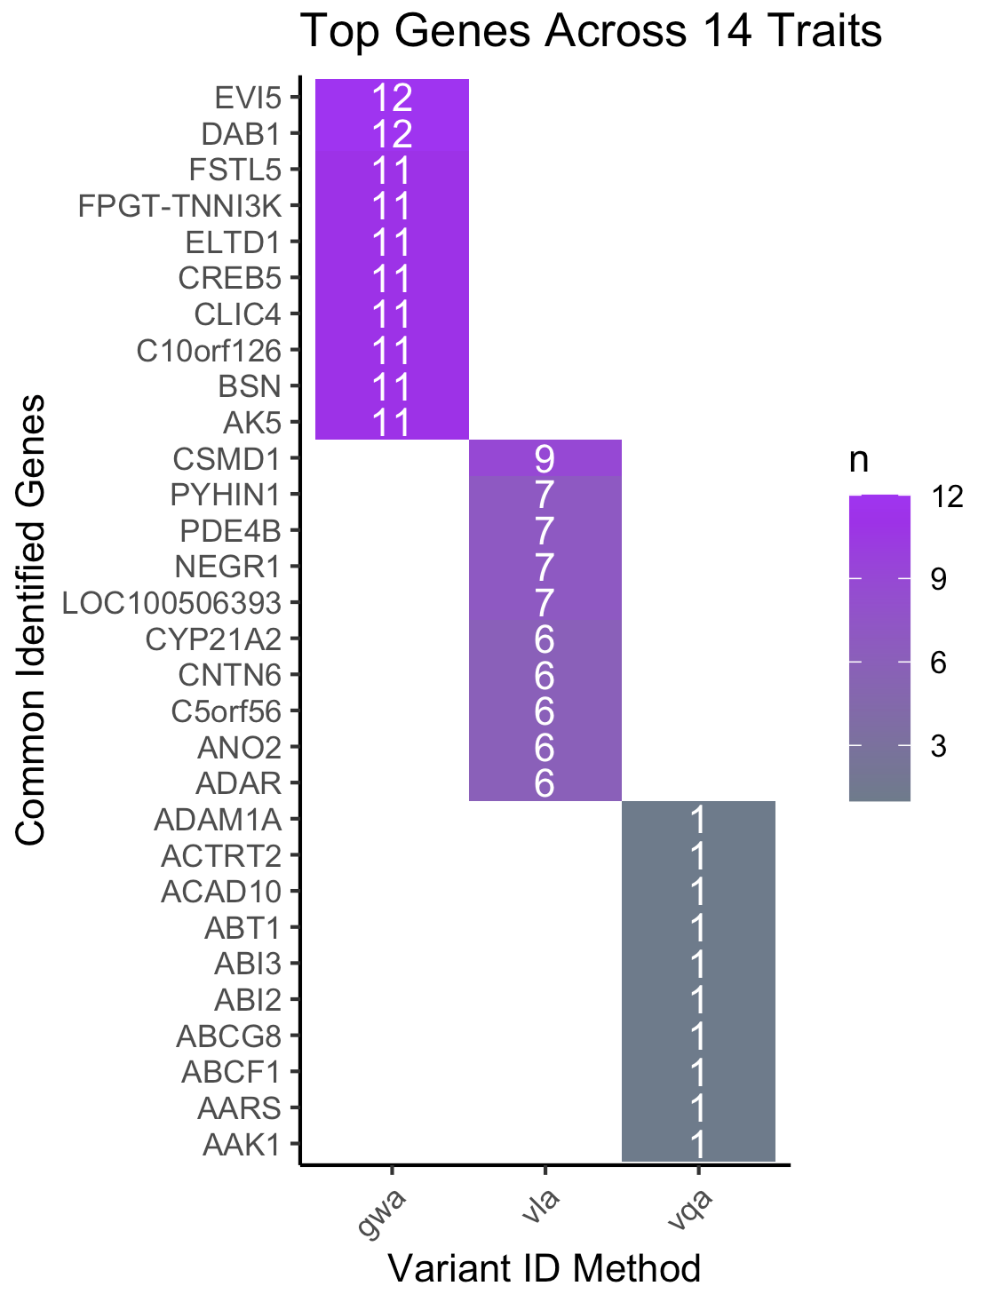
Common Genes Identified by Method
Cell numbers represent how many of the 14 total traits contained variants that mapped to the gene in question
Many of these genes are involved in brain development and signaling

Slide 8
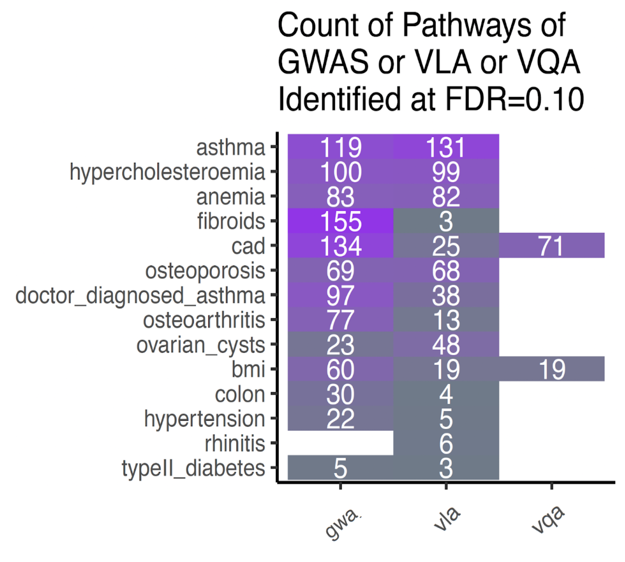
Pathway Analyses by Outcome & Method
Cell numbers are the number of enriched pathways
VQA only with continuous traits is expected
Most traits have enrichment in both mean-based and variance-based methods but with substantial differences in some cases (fibroids)
cv burden

Slide 9
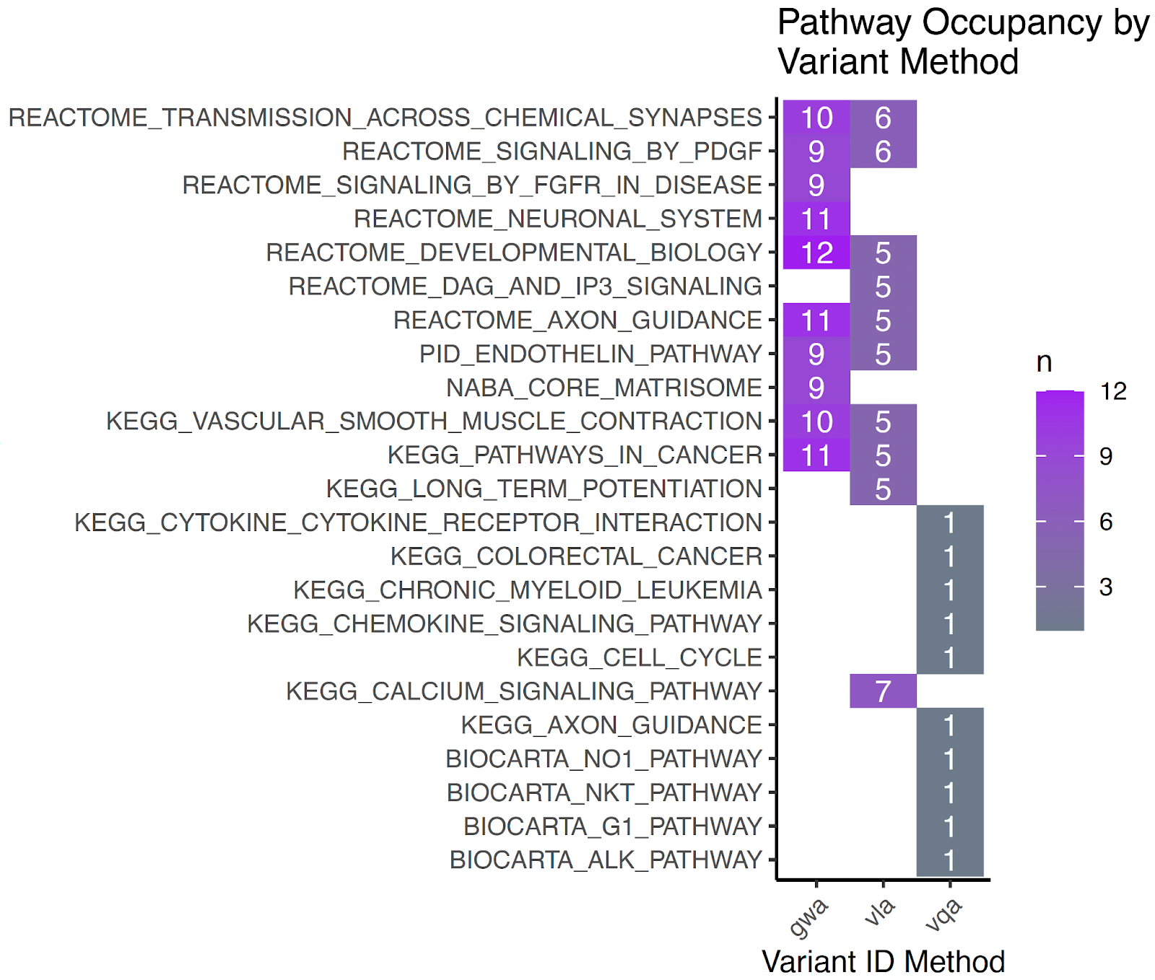
Common Pathways
Cellular signaling and Neuronal signaling related pathways are a common component across traits and methods
Some differences in mean-based (GWAS) and variance-based methods (VLA)

Slide 10
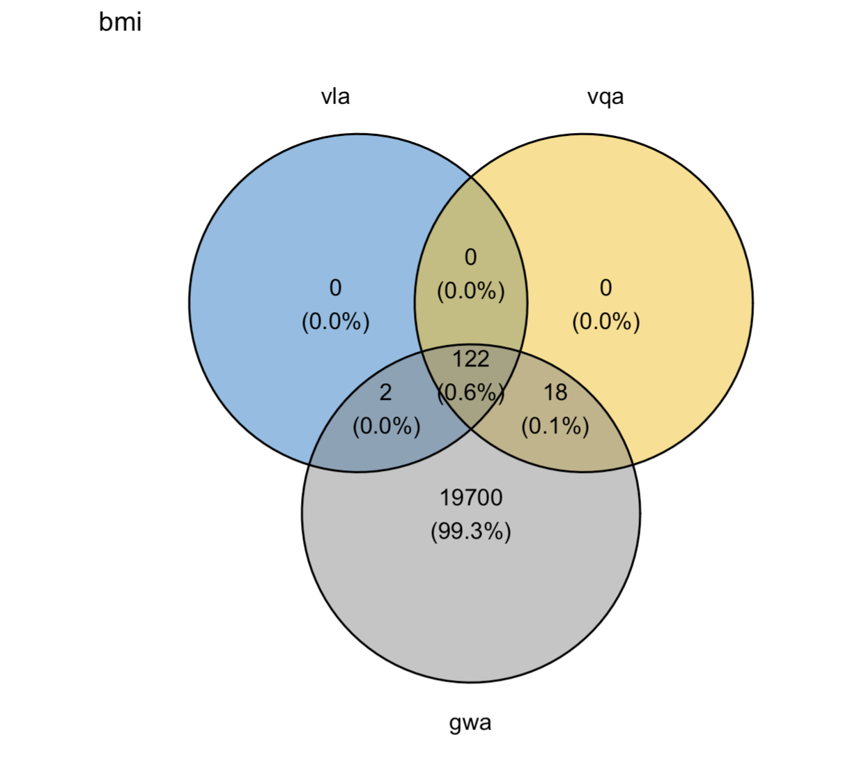
Overlap Between Mean-Based and Variance-Based Methodologies
For continuous outcomes, do VLA and VQA behave similarly rather than a mean-based approach?
Variance-based are much more discriminate

Slide 11
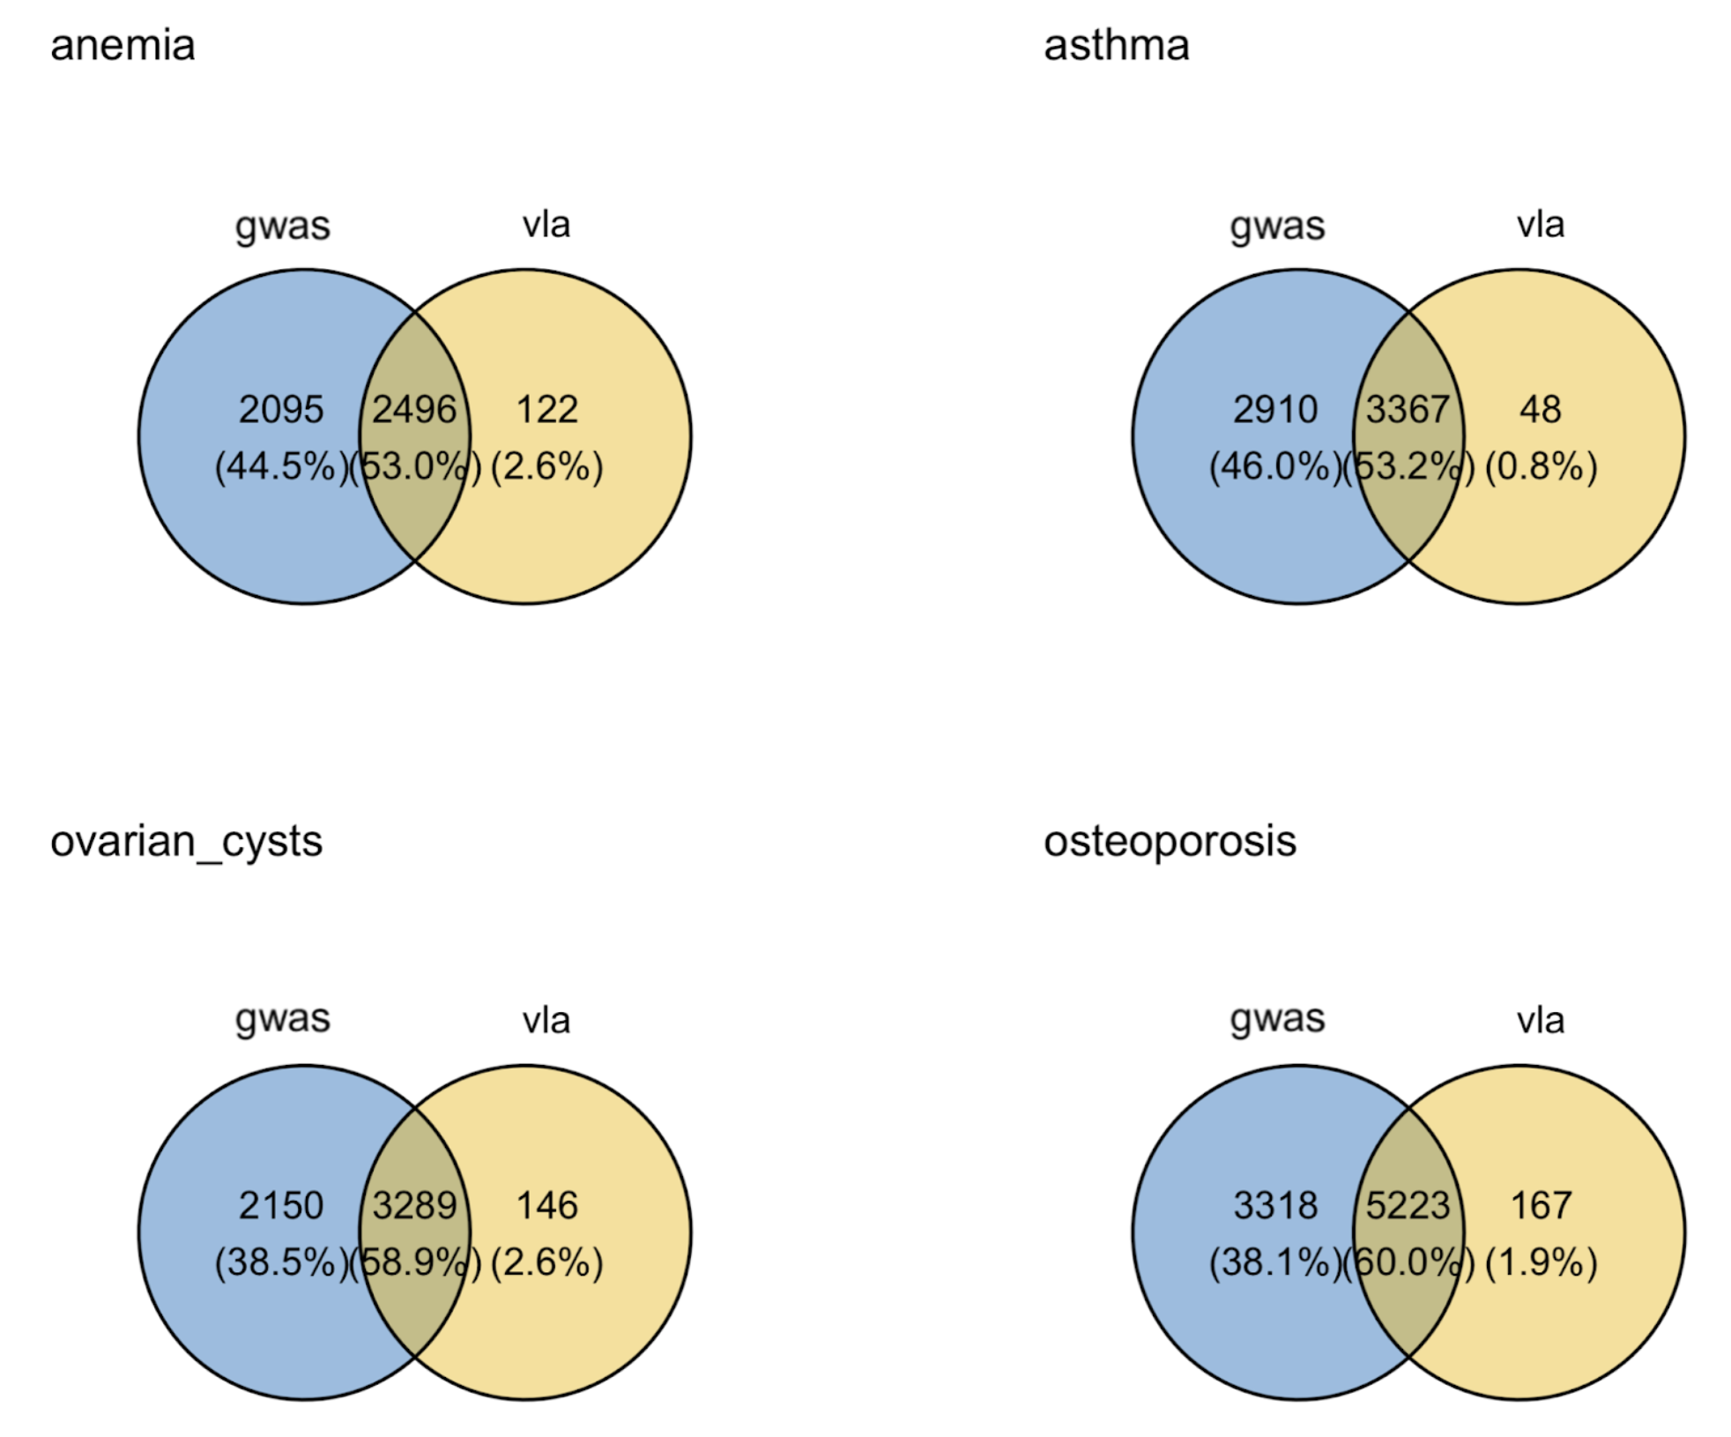
Overlapping Genes Identified Between Mean-Based and Variance-Based Methodologies
Mean-based GWAS identifies more variants (and genes)
Variance-based VLA has substantial overlap but is more discriminate and identifies unique variants not found with GWAS

Slide 12
Results Summary
Gene occupancy found top hits in brain development and signaling in these 14 outcomes as likely candidates for GxE hits
Pathway analysis revealed that neuronal signaling and cellular signaling pathways come up repeatedly across these 14 outcomes

Slide 13
Results Summary Part 2
In dichotomous outcomes:
VLA performs well in identifying variance-based variants likely to be associated with GxE
With many of the same variants as GWAS
With tendency to be more discriminate than GWAS
As expected VQA only identifies candidates for continuous traits
In continuous outcomes:
Gene counts are the highest in the GWAS variant ID method
VQA and VLA identified candidate genes are largely overlapping

Slide 14
Discussion and Conclusions
Mapping methods to find candidate SNPs from UKBiobank in studies with both genetics and the environment
Identified likely GxE candidate loci variants to enable sufficient power
Variants identified by VLA and subsequent pathway analysis results point to findings with overlap and uniqueness from GWAS
Asthma – with one of the highest number of VLA identified variants, is known to be heavily associated with both genetics and environmental exposures

Slide 15
Acknowledgements
John House, PhD. (NSCP Mentor)
Xiaoran Tong, PhD. (VLA Method)
Alison Motsinger-Reif, PhD. (AMR Research Group)
Farida Akhtari, Eunice Lee, Dillon Lloyd, Jasmine Mack, Ziyue Wang
National Institute of Environmental Health Sciences (NIEHS) & NSCP 2021-2022
Suchandra Bhattacharjee, PhD.
Ericka Reid, PhD.
UKBiobank participants

Slide 16
Abstract
Background: Gene by environmental (GxE) interactions refer to environmental exposures and inter-individual genetic variation that interact to confer different risk profiles for a disease outcome. Testing GxE across millions of genetic variants comes with statistical power issues that have recently been overcome with new methods for identifying candidate GxE variants. Assessment of unique and common pathways and genes from likely GxE candidates may inform future research needs in addressing health outcomes.
Objective: Use candidate GxE loci identified with three different methods to compare and contrast methods for identifying likely GxE candidates in 14 health outcomes in the UKBiobank.
Methods: We assessed these methods for ~12 variants and 14 human-health outcomes and applied a Benjamini-Hochberg false discovery rate (FDR) of 0.10 to p-values, and filtered variants were mapped to the closest gene. The unique gene list from each method and disease was then used for pathway analysis using the MsigdbC2CPAll ontology set in the XGR R package. All analyses were conducted using R4.0.5.
Results/Conclusions: As expected, VQA only performs on continuous outcomes, whereas VLA works well on binary outcomes. Interestingly, neuronal signaling and cellular signaling pathways come up repeatedly across these outcomes. Variants were often close to or in genes associated with brain development and signaling. In summary, VLA identifies GxE candidates and this work suggests that some candidates are common across multiple human-health outcomes. Further investigation of genetic variants in cohorts with outcome- associated exposures may be useful to predict the risk of complications in the context of GxE

