Slide 1
Identification of Putative Gene by Environment Variants with Variance Loci Analysis Reveals Unique and Common Pathways and Genes in UKBiobank Disease Outcomes
Violet Evans
Motsinger-Reif Research Group
National Institute of Environmental Health Sciences Scholars Connect Program Symposium (NSCP)
Notes:
Comparison of Gene by Environment Loci Identification Methods in UKBiobank

Slide 2

Background
Objective: Compare and contrast method results for identifying likely GxE candidate loci in 14 health outcomes using pathway analysis in the UKBiobank
Source Data:
The UKBiobank is a large biomedical database that contains genetic and health information from 500,000+ UK citizens
British white individuals were assessed with three methods for identification of GxE candidate loci from ~12 million variants

Slide 3
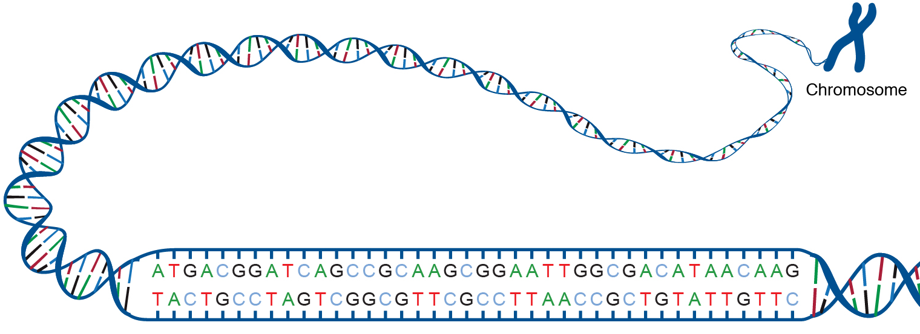
Single Nucleotide Polymorphism (SNP)
7
Parent 1
For a given chr:position
Common Allele = G
Minor Allele = T
Possible Genotypes
  GG - 0 copes of minor allele
  GT - 1 copy of minor allele
  TT - 2 copies of minor allele
12,525,232
Parent 2
7
Single Nucleotide Polymorphism (SNP)
T
A
https://www.genome.gov/genetics-glossary/acgt
3
Notes:
3

Slide 4
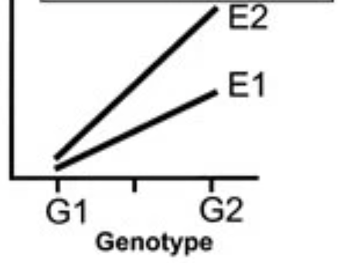
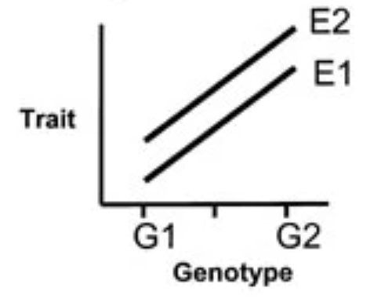
Gene x Environment Interactions – What do we mean?
Genetics influences how the same exposure can result in different responses across individuals
Gene x Environment interaction－ trait of interest is affected differently across genotype between exposed and non-exposed individuals
Example－ Skin cancer and sunlight exposure –
  E1 – Minimal lifetime SUN exposure
  E2 – Substantial lifetime SUN exposure
Skin Cancer
Genotype Effect – Slope != 0
Exposure Effect – E2 has increased response(trait)
No GxE – slopes are the same between
E1 and E2
Genotype Effect – Slope != 0
But E2 exposure changes the slope of the genotype effect while E1 does little
-> GxE
Notes:
Genetics influences how the same exposure can result in different responses across individuals, whether to a pollutant or drug. For example, both genetics and environmental exposures play a role in the risk of skin cancer. Some genomic variants confer greater risk for developing skin cancer. Likewise, more environmental sunlight exposure also confers increased risk of cancer. An example of a gene x environment interaction would be where individuals with certain genetic variants have increased skin cancer risk compared to those without, for similar sunlight exposures.

Slide 5
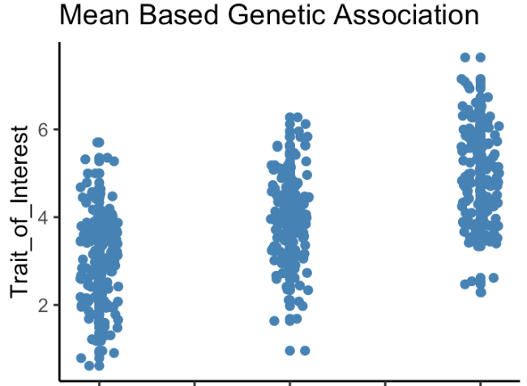
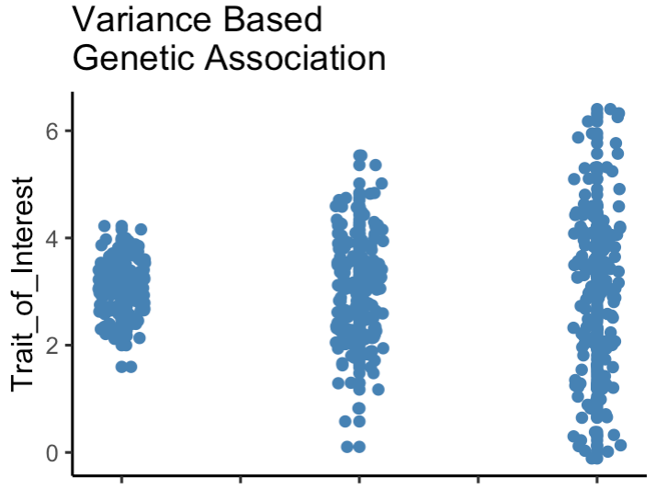
Candidate Identification Methods
GWAS (Genome-Wide Association Studies): an established means-based approach to identifying variants associated with phenotype
VQA (Variance Quantitative-Trait-Loci Analysis): an established method for identifying candidate loci based on non-constant variance across phenotype by genotype
GG GT TT
VLA (Variance Loci Analysis): a novel variance-based approach created by Xiaoran Tong, PhD. (NIEHS), applicable to binary outcomes
GG GT TT
Notes:
VARIANCE based methods have been shown to identify loci with a good potential to exhibit GxE

Slide 6
Methods- Continued.
Candidate variants mapped to the nearest gene
Conducted Pathway Analysis
  MsigdbC2CPAll ontology set, a curation from online pathway databases and biomedical literature
  Representing specific well-defined biological states of processes
  Identify if candidate nearest genes are over-represented in these ontology sets
Assessed unique gene and pathway counts across 14 traits using XGR in R- 4.0.5
Used rigorous correction for multiple testing
rs1002656
rs1194949138
MIR4255
rs1640881087
Chromosome 1
Notes:
Single nucleotide polymorphisms, frequently called SNPs (pronounced “snips”), are the most common type of genetic variation among people
Each SNP represents a difference in a single nucleotide
Candidate variants at a FDR of 0.10 were mapped to a nearest gene
That unique gene list was then used for pathway analysis

Slide 7
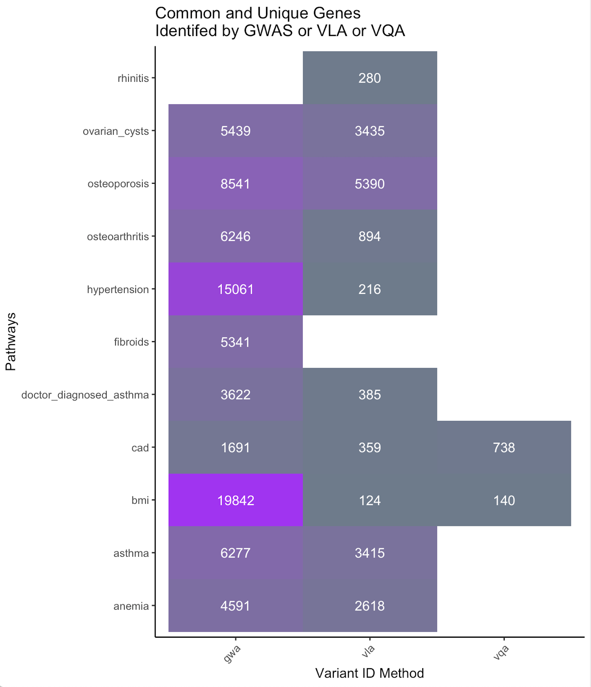
Unique Genes Identified by Method
Significant Genes by Method
GWAS: prolific and maps to more unique genes
VQA: works only with continuous traits
VLA: identifies genes in dichotomous traits based on non-constant variance across genotype
cv burden

Slide 8
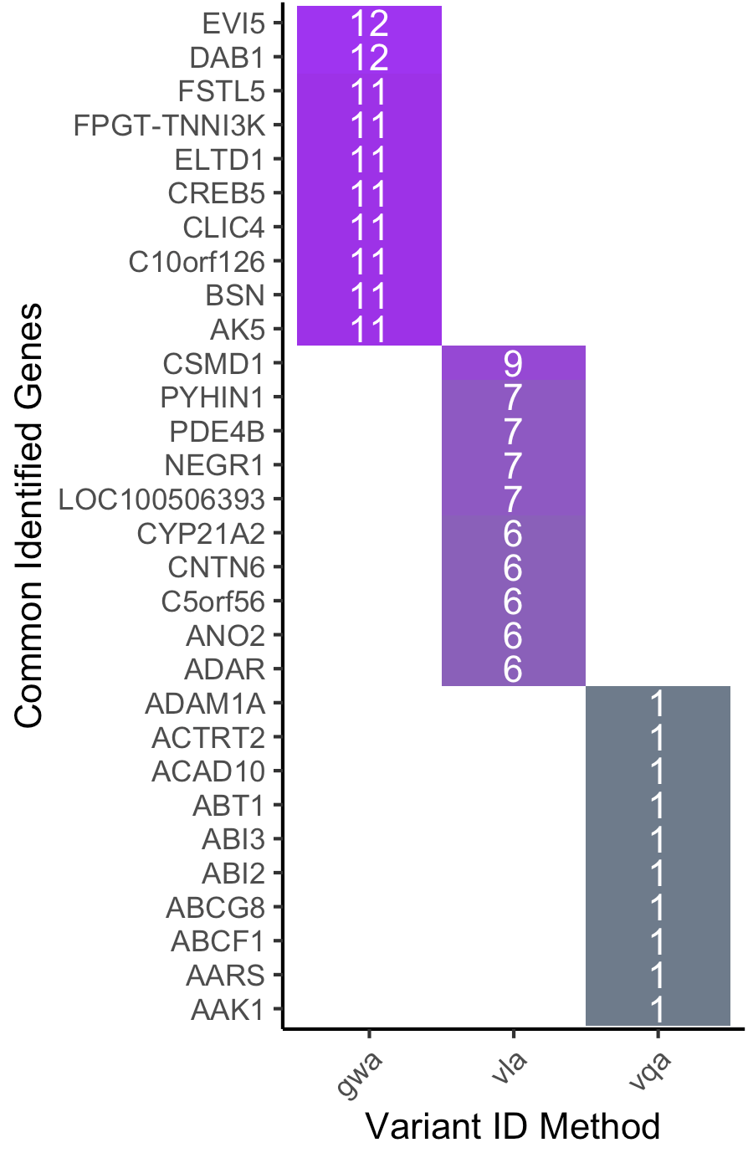
Common Genes Identified by Method
Most Common Genes
Cell numbers represent how many of the 14 total traits contained variants that mapped to the gene in question
Many of these genes are involved in brain development and cellular signaling

Slide 9
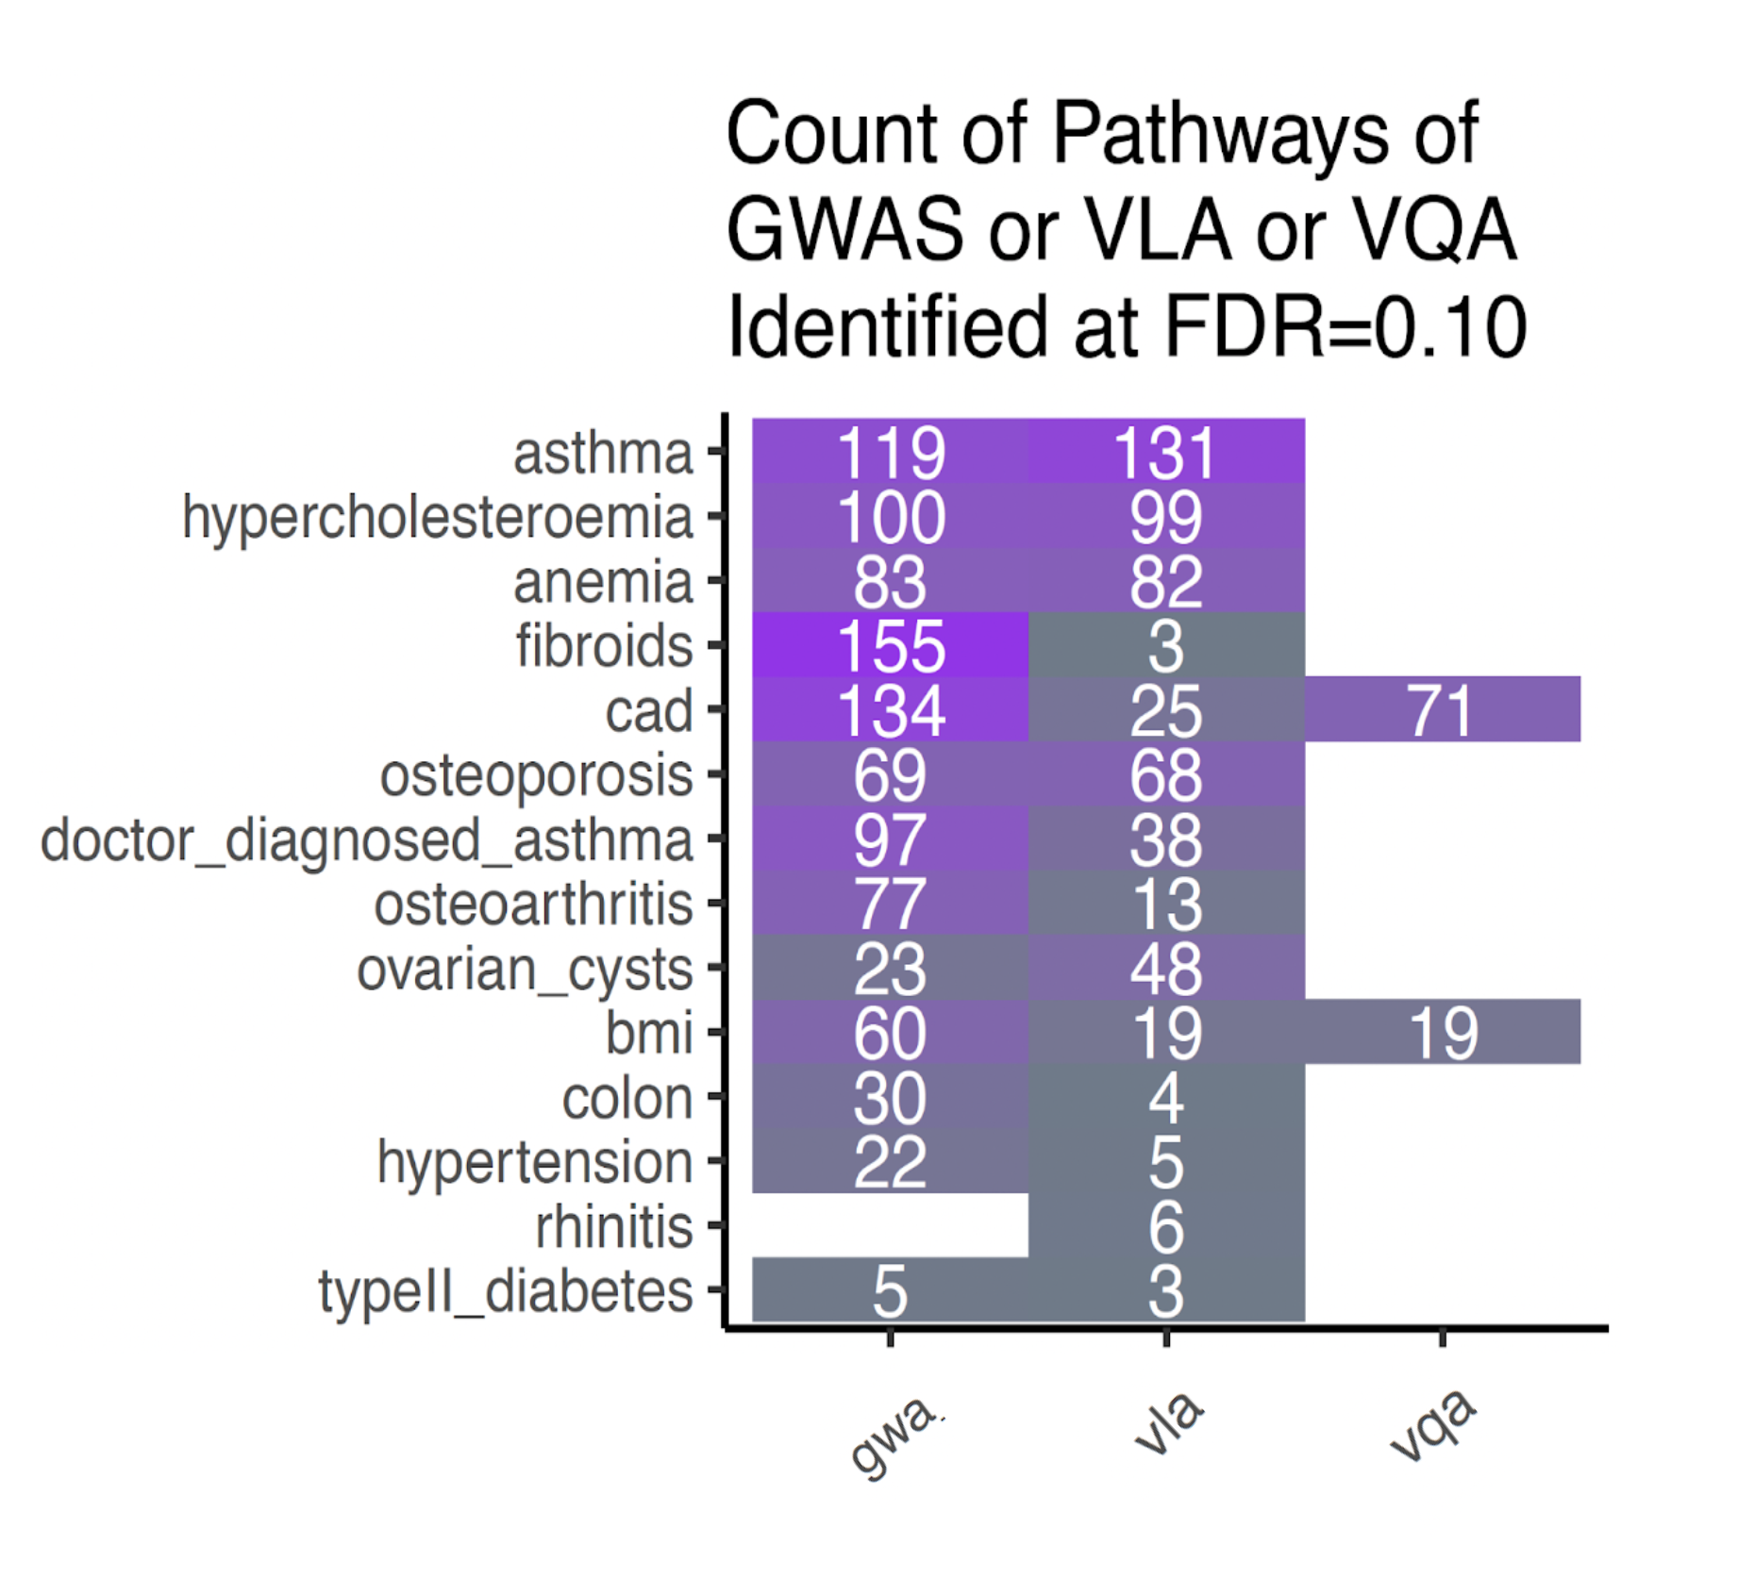
Pathway Analyses by Outcome & Method
Identified Pathways – FDR 10%
Cell numbers are the count of significantly enriched pathways
VQA only with continuous traits is expected
Most traits have enrichment in both mean-based and variance-based methods but with substantial differences in some cases (fibroids)
cv burden

Slide 10
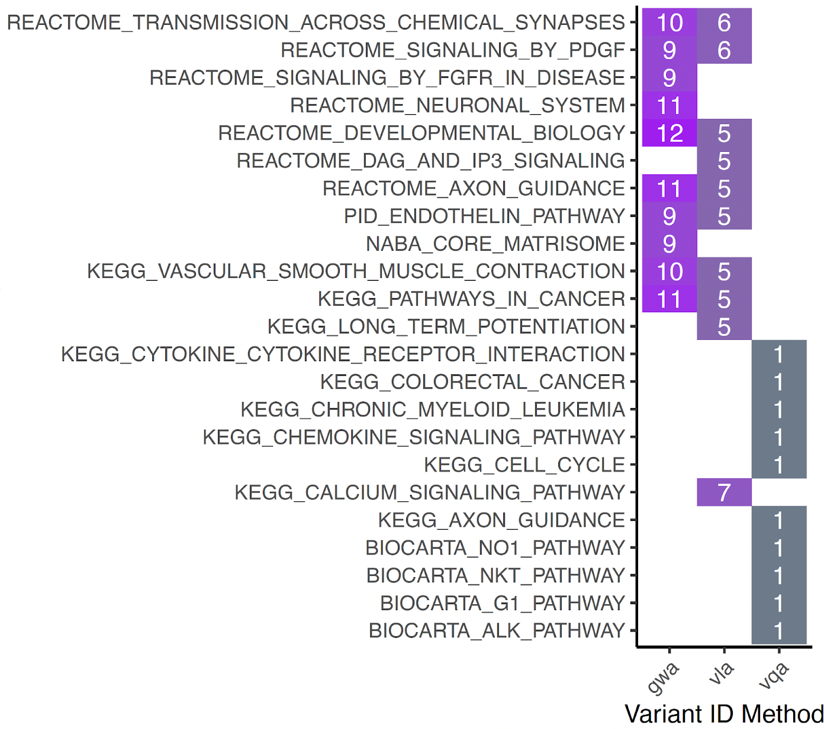
Common Pathways
Pathway Prevalence Across Traits
Cell numbers represent pathways significance counts per outcome
Cellular signaling and Neuronal signaling related pathways are a common component across traits and methods
Some differences in mean-based (GWAS) and variance-based methods (VLA)

Slide 11
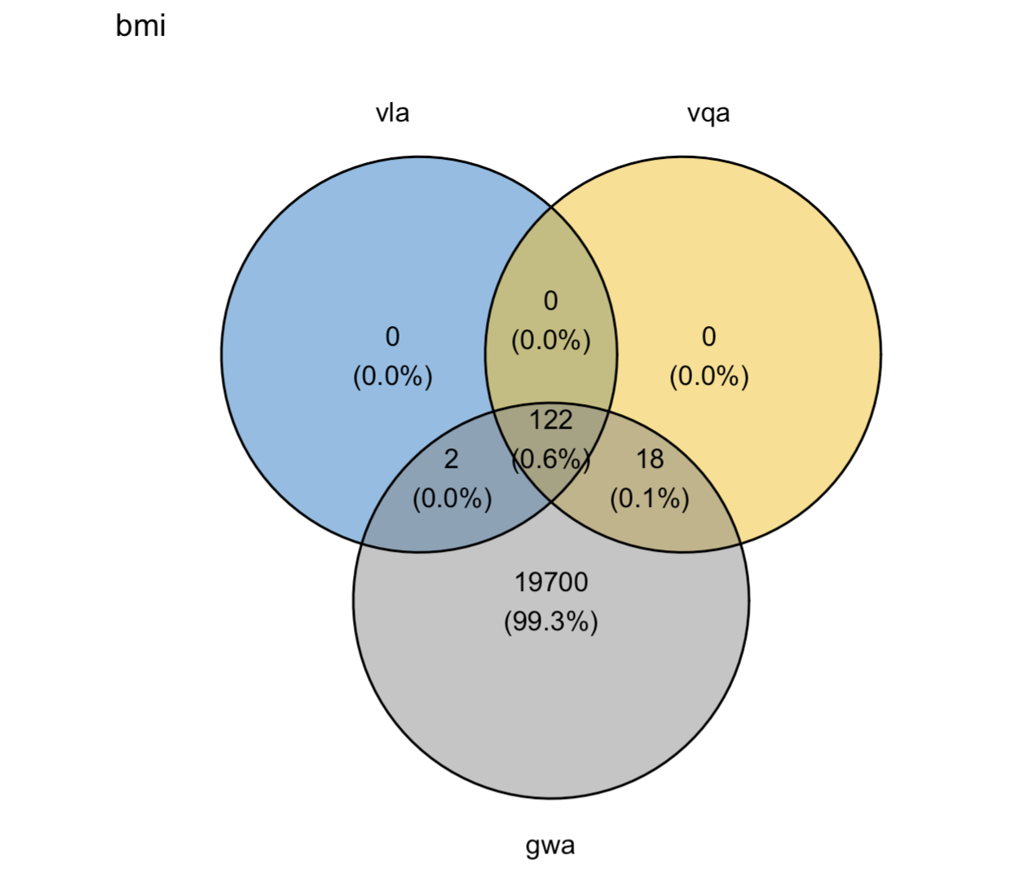
Overlap Between Mean-Based and Variance-Based Methodologies
For continuous outcomes, variance-based methods exhibit high degree of overlap
Variance-based are much more discriminate than mean-based methods (GWA)

Slide 12
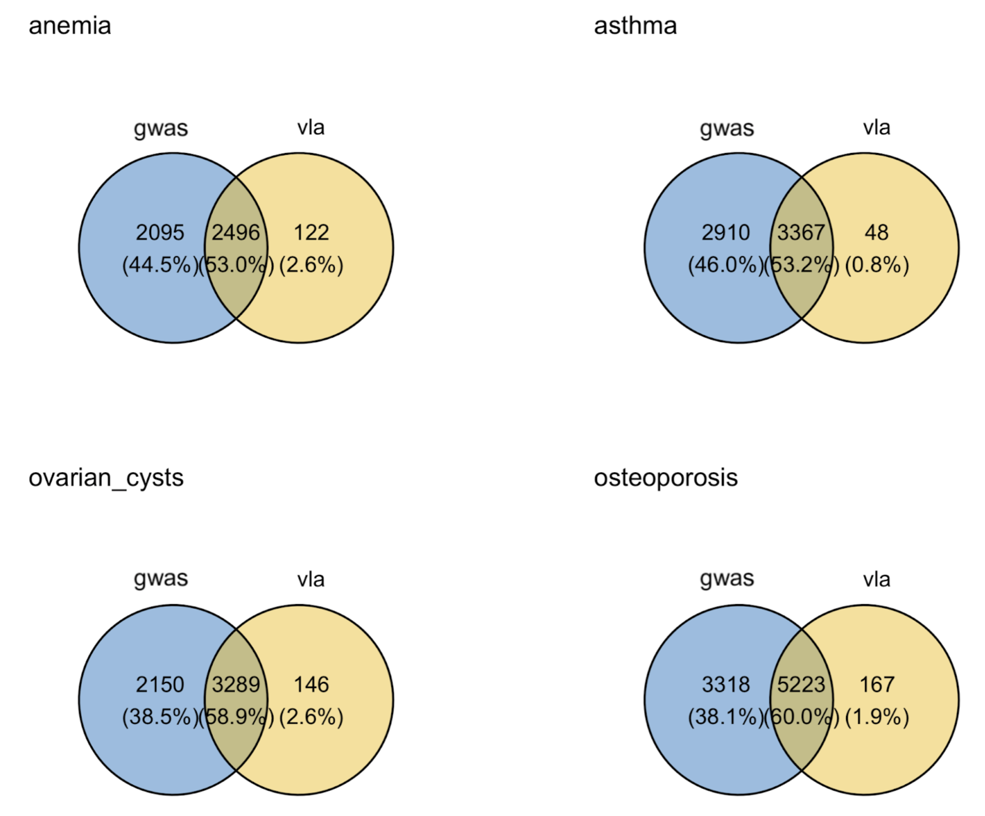
Overlapping Genes Identified Between Mean-Based and Variance-Based Methodologies
Mean-based method identifies more candidates
Variance-based VLA has substantial overlap but is more discriminate and identifies additional unique variants

Slide 13
Results Summary
Identified variants in and around genes related to brain development and signaling are common GxE candidates across multiple human health related traits
Likewise, pathway analysis revealed common enrichment of pathways related to neuronal signaling and cellular signaling across these 14 outcomes

Slide 14
Results Summary Part 2
In dichotomous outcomes:
  VLA performs well in identifying variance-based variants likely to be associated with GxE
    With many of the same variants as GWAS
    With additional unique variants
  As expected VQA only identifies candidates for continuous traits
In continuous outcomes:
  Gene counts are the highest in the GWAS variant ID method
  VQA and VLA identified candidate genes are largely overlapping

Slide 15
Discussion and Conclusions
Mapping methods to find candidate SNPs from UKBiobank in studies with both genetics and the environment
Identified likely GxE candidate loci variants to enable sufficient power
Variants identified by VLA and subsequent pathway analysis results point to findings with overlap and uniqueness from GWAS
Asthma – with one of the highest number of VLA identified variants, is known to be heavily associated with both genetics and environmental exposures

Slide 16









Acknowledgements
Alison Motsinger-Reif
John House, PhD. (NSCP Mentor)
Xiaoran Tong, PhD. (VLA Method)
Alison Motsinger-Reif, PhD. (AMR Research Group)
  Farida Akhtari, Eunice Lee, Dillon Lloyd, Jasmine Mack, Ziyue Wang
National Institute of Environmental Health Sciences (NIEHS) & NSCP 2021-2022
  Suchandra Bhattacharjee, PhD.
  Ericka Reid, PhD.
UKBiobank participants
John Xiaoran Farida Eunice
Dillon Ziyue Jasmine Violet

Slide 17


Slide 18
Abstract
Background: Gene by environmental (GxE) interactions refer to environmental exposures and inter-individual genetic variation that interact to confer different risk profiles for a disease outcome. Testing GxE across millions of genetic variants comes with statistical power issues that have recently been overcome with new methods for identifying candidate GxE variants. Assessment of unique and common pathways and genes from likely GxE candidates may inform future research needs in addressing health outcomes.
Objective: Use candidate GxE loci identified with three different methods to compare and contrast methods for identifying likely GxE candidates in 14 health outcomes in the UKBiobank.
Methods: We assessed these methods for ~12 variants and 14 human-health outcomes and applied a Benjamini-Hochberg false discovery rate (FDR) of 0.10 to p-values, and filtered variants were mapped to the closest gene. The unique gene list from each method and disease was then used for pathway analysis using the MsigdbC2CPAll ontology set in the XGR R package. All analyses were conducted using R4.0.5.
Results/Conclusions: As expected, VQA only performs on continuous outcomes, whereas VLA works well on binary outcomes. Interestingly, neuronal signaling and cellular signaling pathways come up repeatedly across these outcomes. Variants were often close to or in genes associated with brain development and signaling. In summary, VLA identifies GxE candidates and this work suggests that some candidates are common across multiple human-health outcomes. Further investigation of genetic variants in cohorts with outcome- associated exposures may be useful to predict the risk of complications in the context of GxE

