Slide 1
Cataloging gene-environment interaction candidate SNPs for over 3,000 UK Biobank disease phenotypes through variance loci analysis.
Extension of variance Quantitative Trait Loci analysis to support binary traits
Xiaoran Tong, National Institute of Environmental Health Sciences
Alison A. Motsinger-Reif National Institute of Environmental Health Sciences

Slide 2
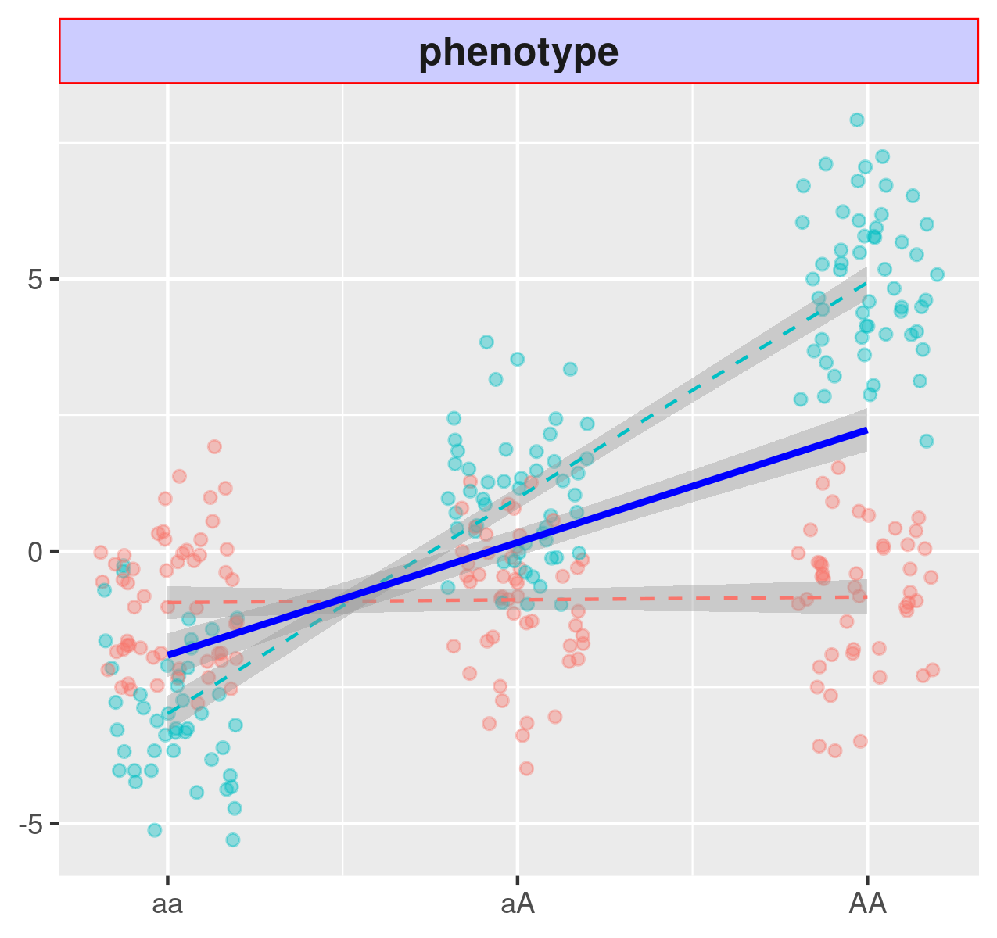
Interaction between Genes and Environment Exposure
teal/red: the sample exposed to an environment (yes / no);
blue: the marginal variant effect.
Environment 0
Environment 1
Marginal
A GxE interaction modifies genetic effect on health outcomes;
Significant GxE may suggest targets of intervention in the environment.

Slide 3
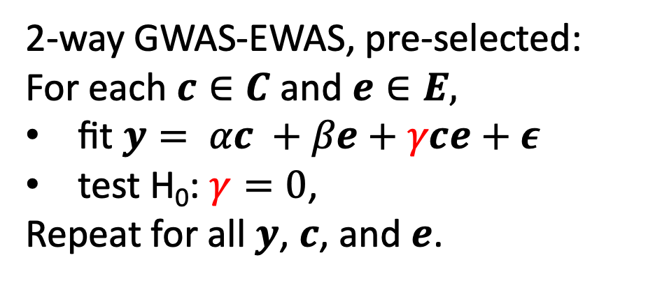
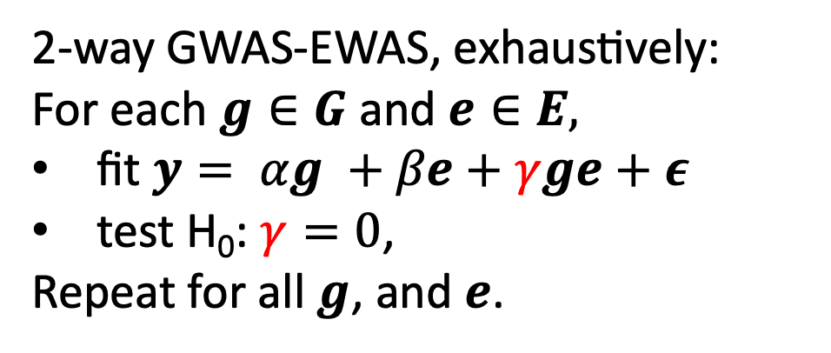
Detecting GxE: Brute Force versus pre-selection
Whole Genome Variants
2-way GWAS-EWAS, exhaustively:
For each $g∈G$ and $e∈E,$
fit $y= αg +βe+γge+ε$
test H₀: $γ=0$,
Repeat for all $g$, and $e$.
Exposome
Variables
GxE
SNP
✖️
2-way GWAS-EWAS, pre-selected:
For each $c∈C$ and $e∈E,$
fit $y= αc +βe+γce+ε$
test H₀: $γ=0$,
Repeat for all $y$, $c$, and $e$.
Candidates
Exposome
Variables
GxE
SNP
✖️

Slide 4
Catalog GxE candidates for all diseases on NIEHS
NIEHS service: https://edelgene.niehs.nih.gov/vla
Public
GxE candidate catalog
Type 2 Diabetes: GxE candidate Ranking
A study on Type 2 Diabetes,
Genes, and Environment
Phenotype 1
CHR BP Allele RS_ID Rank
13 239911 A>G rs12345 1.1e-8
19 1374399 A>T rs978786 2.1e-7
… … … …
3 9227334 G>T rs567891 4.3e-3
… … … …
1 3267834 G>T rs3939223 9.9e-1
… … … …
Phenotype 2
Exposome
Variables
Top 2: rs12345
rs978786
…
…
…
✖️
Type 2 Diabetes
…
…
…
Phenotype ?
Q: How to determine if a variant is a GxE candidate?

Slide 5
Variance Quantitative Trait Loci (vQTL) indicates unseen GxE

Slide 6
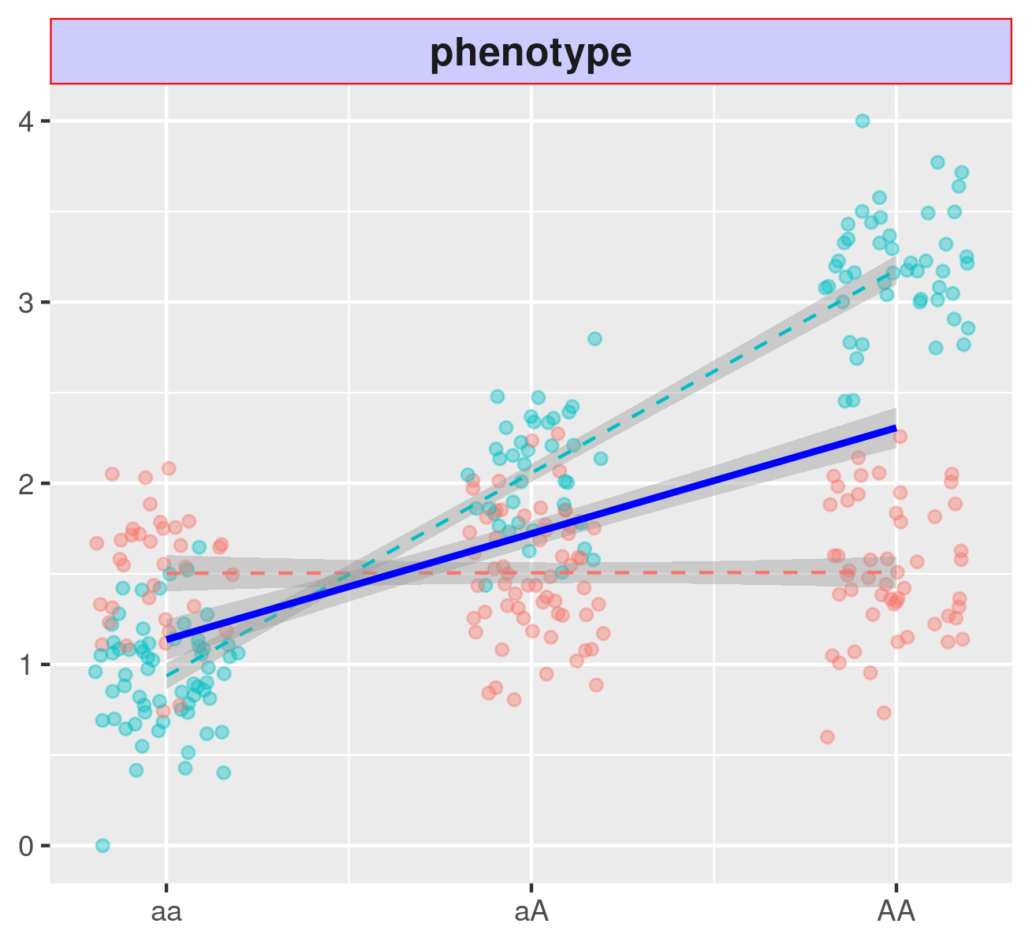
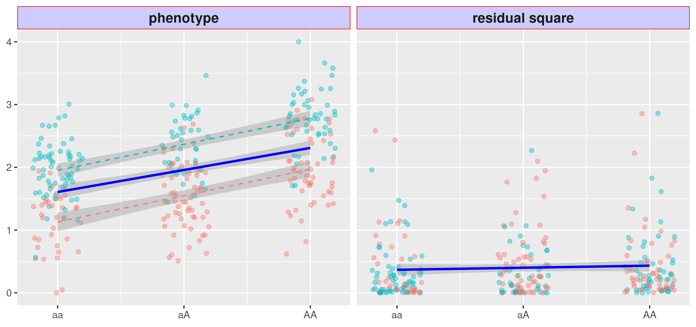
Pre-scan GxE candidate variants: vQTL
Environment 0
Environment 1
Marginal
With GxE, the spread of residual changes; without GxE, it is unform.

Slide 7




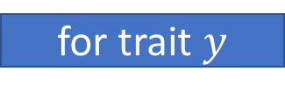

Pre-scan GxE candidate variants: vQTL
Linear Model 1
Linear Model 2
for trait $y$
for variant $g$
$$y=αg+ε$$
$$ε^{2}=βg+ε^{′}$$
next trait
next variant
retain
h₀: $β$=0
reject
add $g$ to GxE Candidates for $y$
Scan for QTL of phenotypic variance, hence the name, vQTL
¹Double Linear Models (DLM)
²Double Generalized Linear Models (DGLM), Levene’s Test (LVT)
³Deviation Regression Models (DRM).
1.Guillaume Paré et al.. On the use of variance per genotype as a tool to identify quantitative trait interaction effects: a report from the women’s genome health study. PLoS Genet, 6(6):e1000981, 2010
2. Huanwei Wang, et al. Genotype-by-environment interactions inferred from genetic effects on phenotypic variability in the uk biobank. Science advances, 5(8):eaaw3538, 2019.
3. Andrew R Marderstein, et al. Leveraging phenotypic variability to identify genetic interactions in human phenotypes. The American Journal of Human Genetics, 2020.

Slide 8








Pre-scan GxE candidate variants: Double Linear Models
Environment 0
$$ε_{AA}$$
Environment 1
Marginal
$$ε_{aA}$$
$$ε_{AA}^{2}$$
$$ε_{aa}^{2}$$
$$ε_{aA}^{2}$$
$$β≠0$$
$$ε_{aa}$$
When GxE exists, DLM fits a non-zero slope, rejecting h₀: $β$=0.

Slide 9







Pre-scan GxE candidate variants: Double Linear Models
Environment 0
Environment 1
Marginal
$$ε_{AA}$$
$$ε_{aA}$$
$$ε_{aa}$$
$$ε_{aa}^{2}$$
$$ε_{aA}^{2}$$
$$ε_{AA}^{2}$$
$$β=0?$$
Otherwise, DLM fits a nearly flat slope, retaining h₀: $β$=0.

Slide 10
Limitation of vQTL Analysis

Slide 11
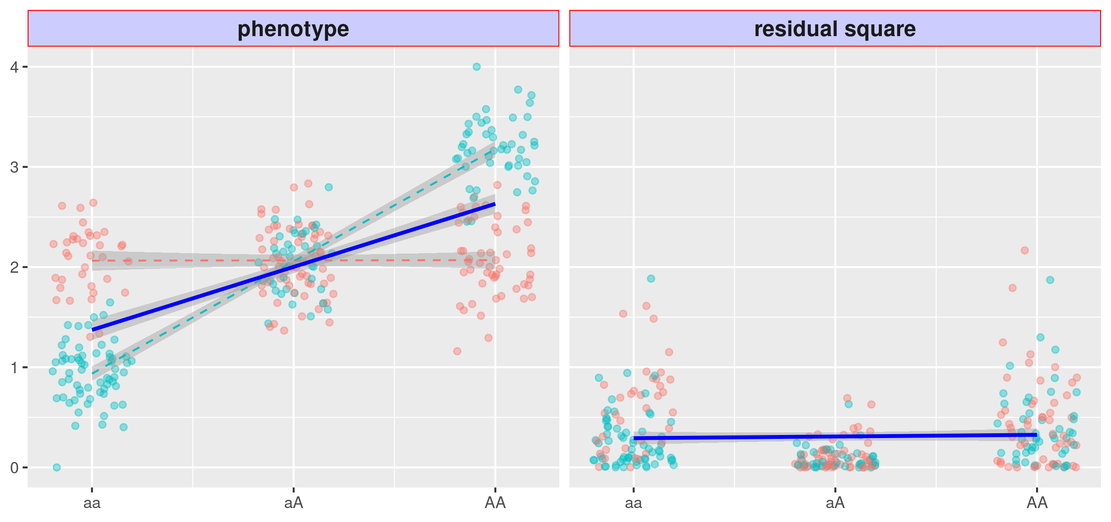







Issues with DLM: null environment main effect
Environment 0
Environment 1
$$ε_{AA}$$
Marginal
$$ε_{aA}$$
$$ε_{aA}$$
$$ε_{aa}^{2}$$
$$ε_{AA}^{2}$$
$$ε_{aA}^{2}$$
$$ε_{aa}$$
With a weak environment main effect, the DLM slope is flat despite existing GxE.

Slide 12












Issues with DLM: type 1 error for binary traits
Environment 0
$$ε_{aa}$$
$$ε_{aA}$$
$$ε_{AA}$$
Environment 1
Marginal
$$ε_{aa}^{2}$$
$$ε_{aA}^{2}$$
$$ε_{AA}^{2}$$
$$ε_{aA}^{2}$$
$$ε_{AA}^{2}$$
$$ε_{aa}^{2}$$
$$ε_{aa}$$
$$ε_{aA}$$
$$ε_{AA}$$
The DLM slope is non-zero despite the absence GxE.

Slide 13
Variance Locus Analysis (VLA)

Slide 14




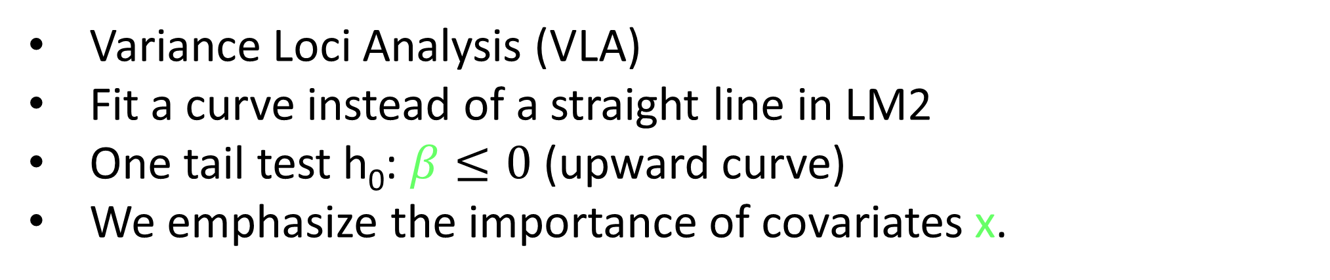

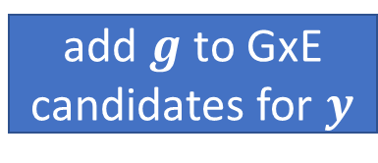
Pre-scan GxE candidate variants: Variance Loci Analysis
Linear Model 1
Linear Model 2
for trait $y$
for variant $g$
$$y=x+αg+ε$$
$$ε^{2}=x+βg^{2}+ε^{′}$$
next trait
next variant
retain
h₀: $β≤0$
reject
add $g$ to GxE candidates for $y$
Variance Loci Analysis (VLA)
Fit a curve instead of a straight line in LM2
One tail test h₀: $β≤0$ (upward curve)
We emphasize the importance of covariates x.

Slide 15
Null environment effect: curve fitting retore power
Environment 0
Environment 1
$$ε_{AA}$$
Marginal
$$ε_{aA}$$
$$ε_{aA}$$
$$ε_{aa}^{2}$$
$$ε_{AA}^{2}$$
$$ε_{aA}^{2}$$
$$ε_{aa}$$
The curve will bend upwards in the presence of GxE.

Slide 16

Binary phenotype: curve fitting control type 1 error
Environment 0
$$ε_{aa}$$
$$ε_{aA}$$
$$ε_{AA}$$
Environment 1
Marginal
$$ε_{aa}$$
$$ε_{aA}^{2}$$
$$ε_{AA}^{2}$$
$$ε_{aA}^{2}$$
$$ε_{AA}^{2}$$
$$ε_{aa}^{2}$$
$$ε_{aa}$$
$$ε_{aA}$$
$$ε_{AA}$$
The curve will not bend upwards in the absence of GxE.

Slide 17
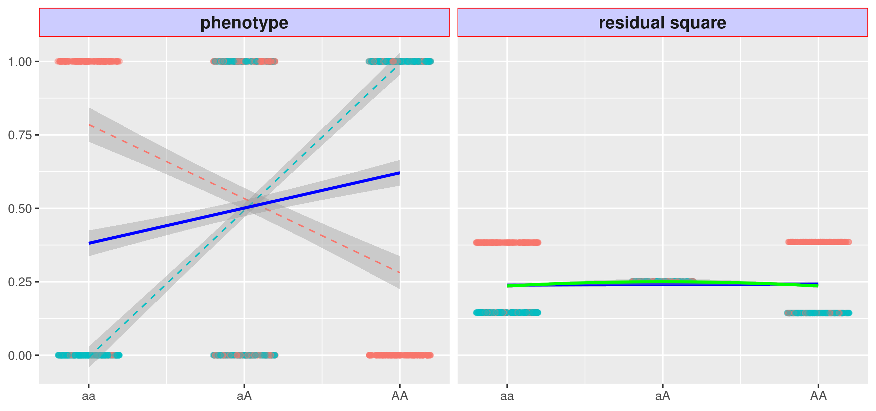
Binary phenotype: lack of power
Environment 0
Environment 1
Marginal
The curve is still flat in the presence of GxE.

Slide 18
Binary phenotype: improve power with covariates
Environment 0
Environment 1
Marginal
Innate risk scores restore the power to detect GxE candidates.

Slide 19
Building GxE candidate Catalog:
Apply VLA to UK Biobank

Slide 20
Scan the entire phenome and genome in the UKBB
3273 phenotype in total, 1,693 disease status;
11 million common genome variants (MAF > 0.005);
26 Covariates:
age, sex, age², sex × age, sex × age²;
first 20 genetic principal components;
genotyping array used.

Slide 21
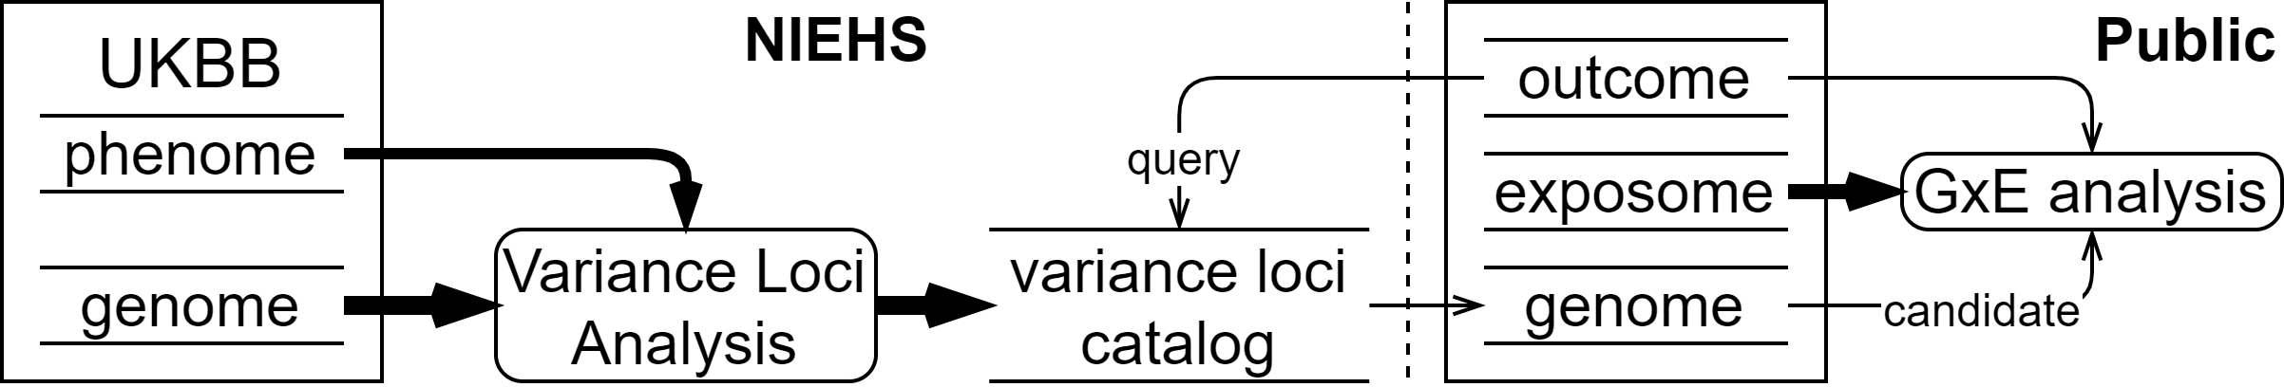
NIEHS Pan-UKBB Variance Loci Catalog
A catalog of genome variant candidacy ranking
https://edelgene.niehs.nih.gov/vla
GxE candidacy ranking based on GWA, vQTL analysis, and VLA;
covers 3273 phenotypes, including most diseases;
Covers four racial groups in the UKBB.
A public source for interested gene-environment research.

Slide 22
Acknowledgement
Alison A. Motsinger-Reif Group support
Alison A. Motsinger-Reif (PI, alison.motsinger-reif@nih.gov),
Dmitri Zaykin (PI),
Olga Vsevolozhskaya (PI, ovs222@g.uky.edu)
Ziyue Wang (ziyue.wang@nih.gov)
Dillon Lloyd (dillon.lloyd@nih.gov)
Eunice Lee (eunice.lee@nih.gov)
Jasmine Mack (mackja@niehs.nih.gov)
Violet Evans (violet.evans@nih.gov)
Maintainers of PEGS (Personalized Environment and Gene Study)
Janet Hall
David Fargo (fargod@niehs.nih.gov)
Charles Schmitt
Shepherd Sherman
High Performance Computation and technical support
John House (john.house@nih.gov)
Compiling UK Biobank Phenome
Farida Akhtari (farida.akhtari@nih.gov)
Thomas Lipscomb (thomas.lipscomb@nih.gov)
IT support for hosting the GxE candidate catalog:
Frank Day (dai3@niehs.nih.gov)
Jason Phillips (jason.phillips@sciome.com)

