Slide 1
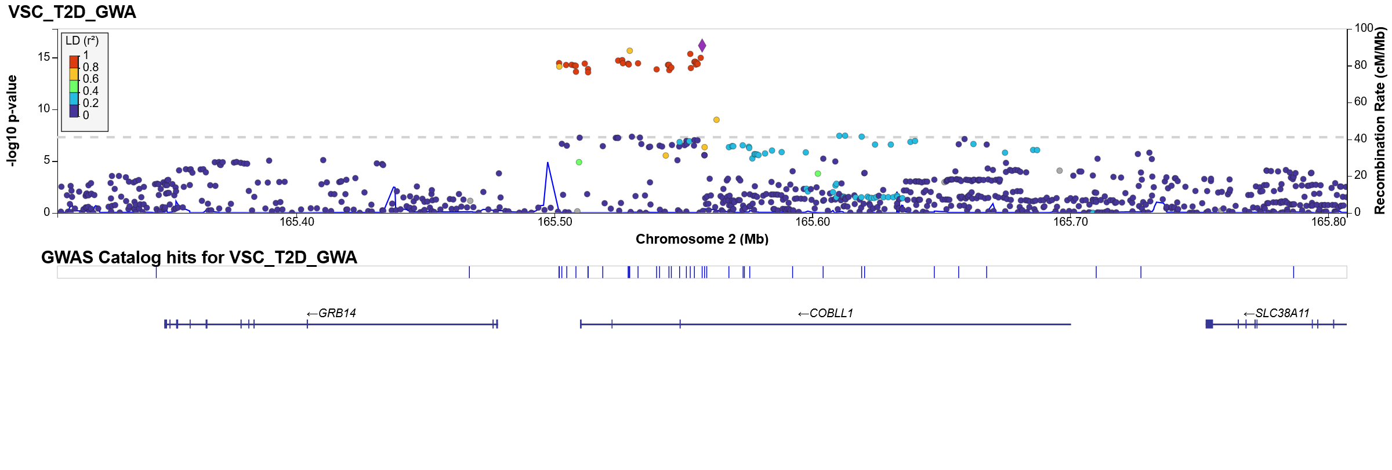
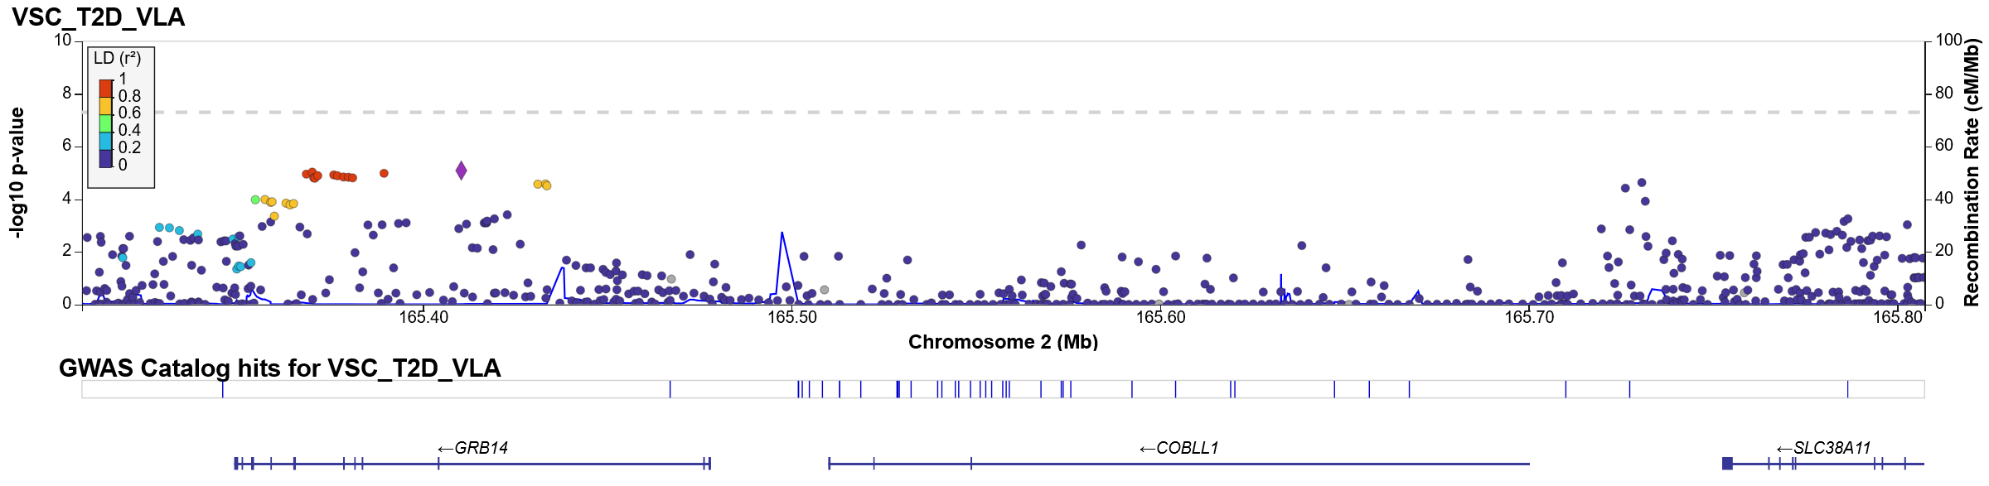
Manhattan plot for regions surrounding rs6712203 (2:165557318, Hg19); Top: GWAS; bottom: VLA

Slide 2

Manhattan plot for regions surrounding rs6712203 (2:165557318, Hg19); Top: DLM; bottom: VLA

Slide 3
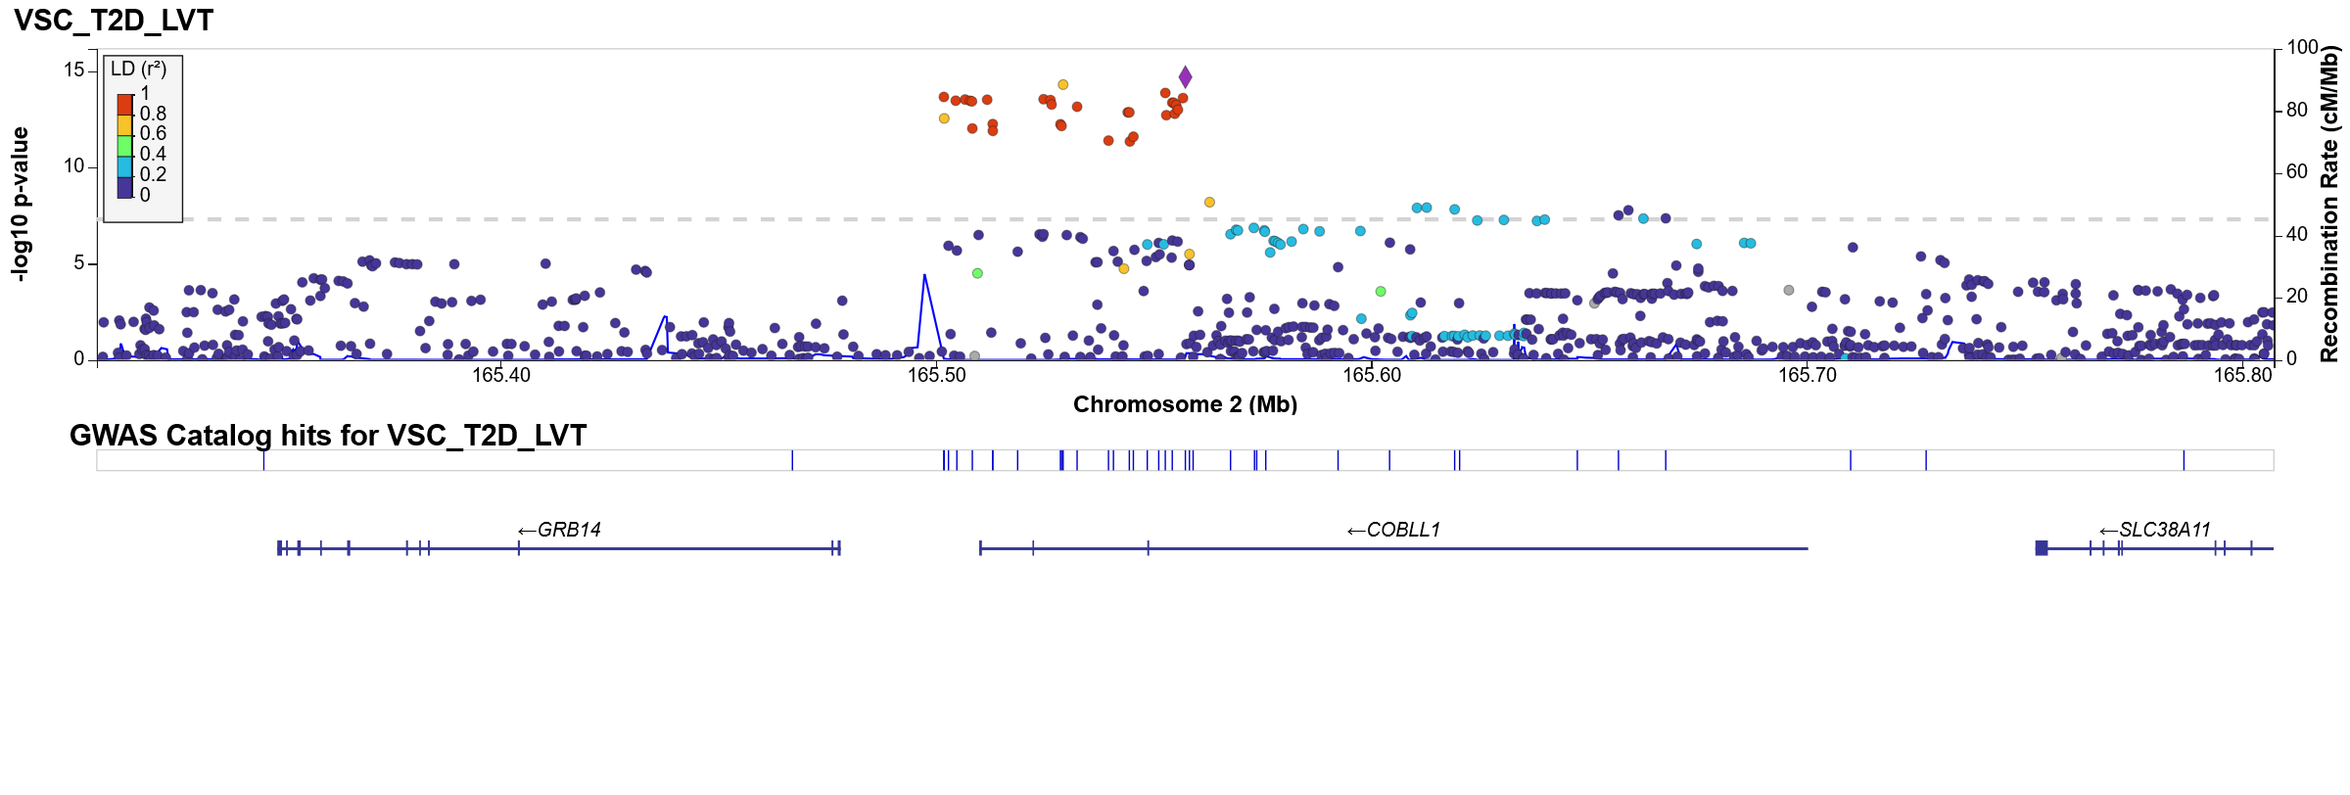
Manhattan plot for regions surrounding rs6712203 (2:165557318, Hg19); Top: LVT; bottom: VLA

Slide 4

Manhattan plot for regions surrounding rs6712203 (2:165557318, Hg19); Top: DRM; bottom: VLA

Slide 5
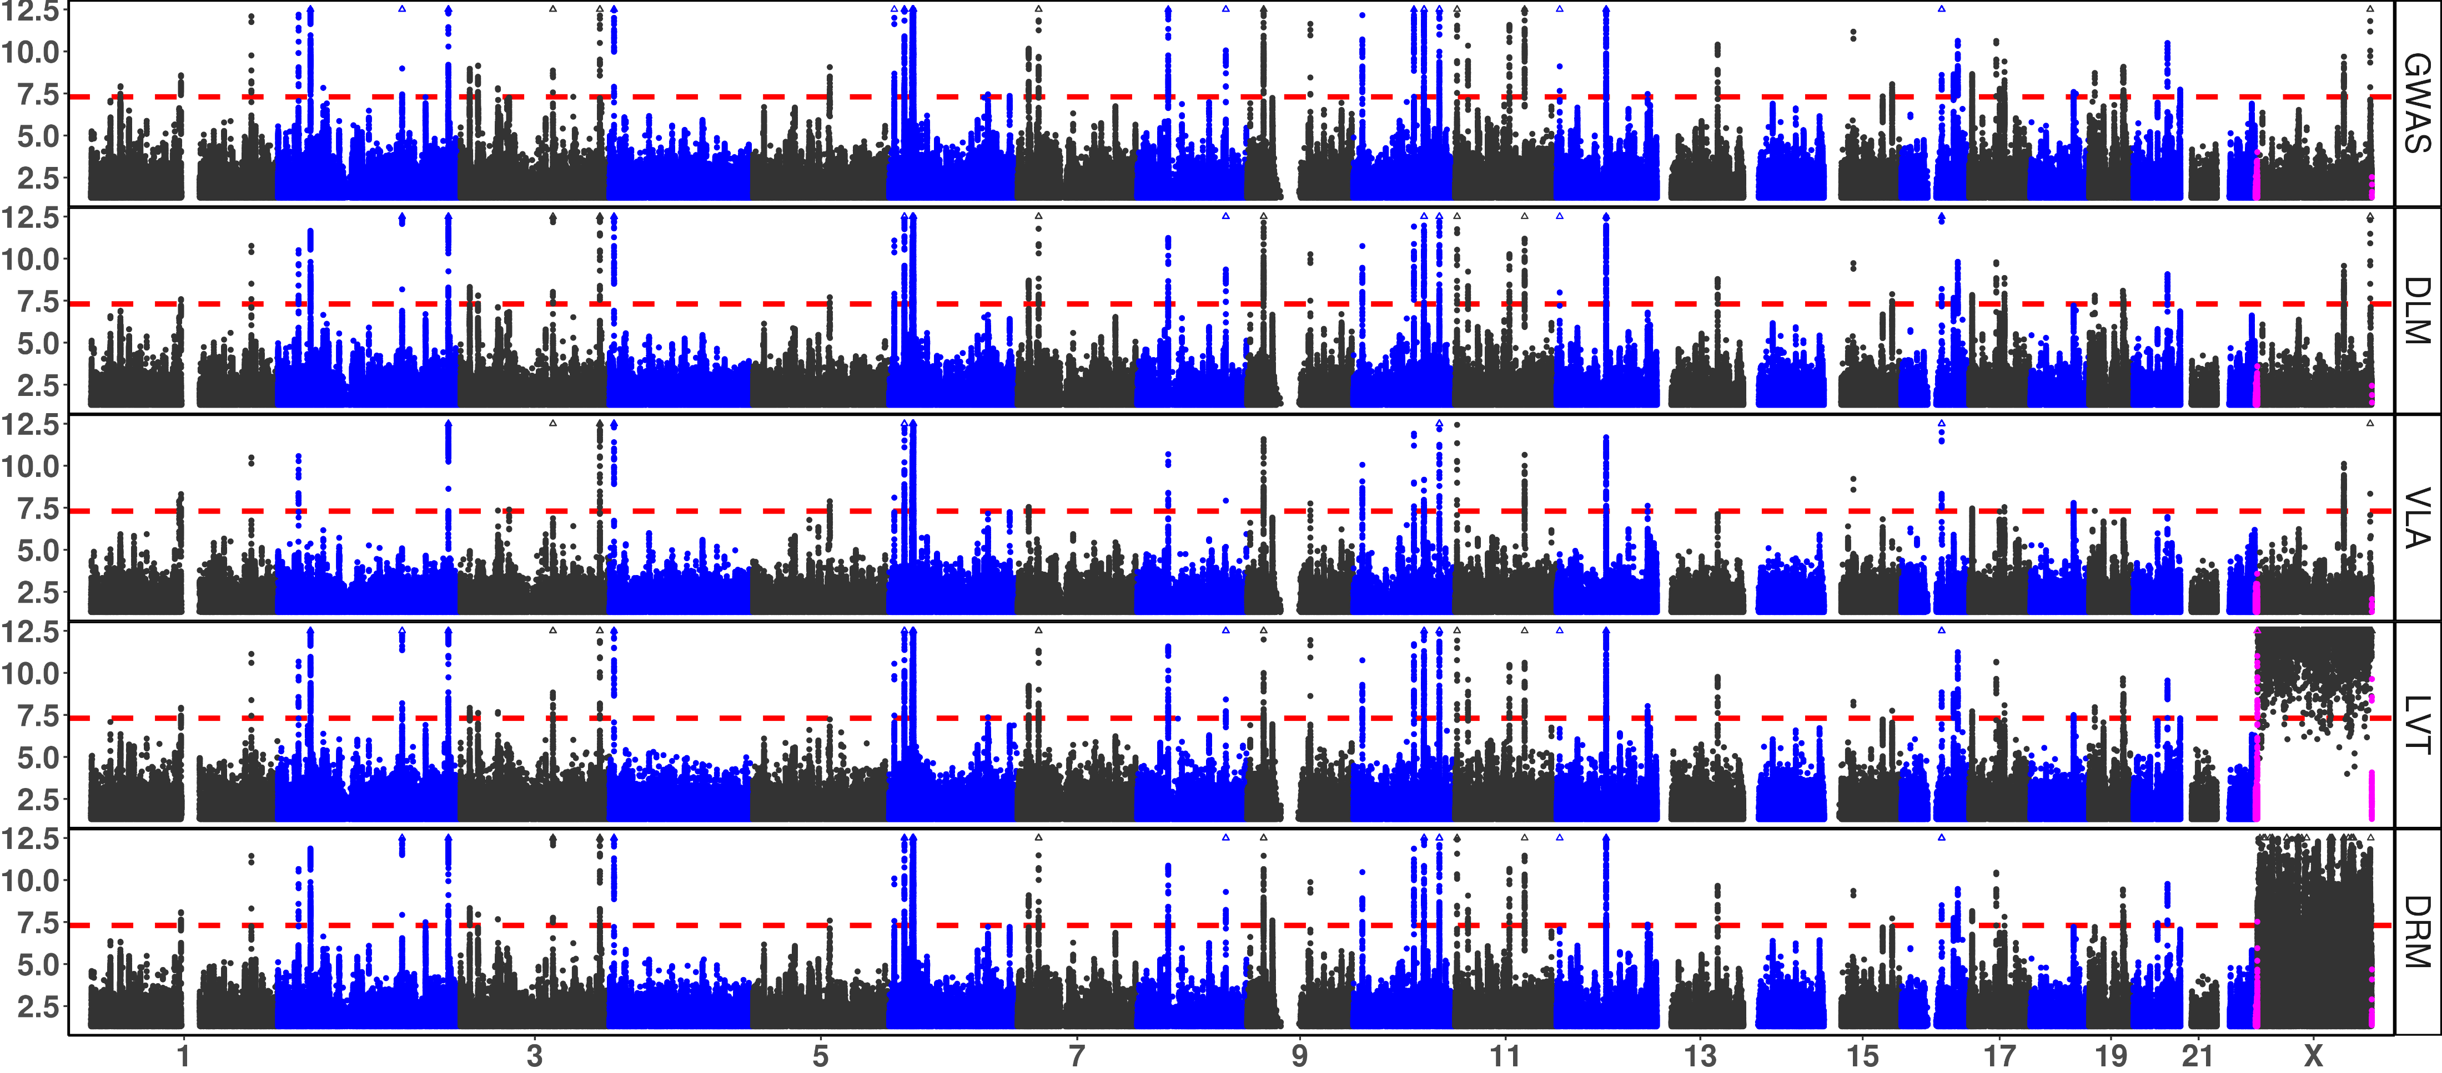
(tentative) Supplement Figure 3b: Manhattan and QQ Plots, with λ_{GC} for Type 2 Diabeties
x-axis: chromosomes (Manhattan plot), theoretical 1 - p (QQ plot 1), or theoretical -log₁₀(p) (QQ plot 2); y-axis: -log₁₀(p) (Manhattan and QQ plot 2), or 1 - p (QQ plot 1); red dash: significance threshold -log₁₀(5e-8) (Manhattan plot); each point bins 269,534 basepairs; magenta points pseudo-autosome regions (PAR) in X; orange circle: abnormal p-values excluded from QQ plots and λ_{GC}; rows: statistical tests, GWAS = genome wide association study; DLM = double linear model, VLA = variance loci analysis (order-2 polynomial positive gradient test), LVT = Levene’s robust test, DRM = Deviation Regression Model; red circle: rs6712203 (Chr2), avoided by VLA but picked up by other tests.

Slide 6
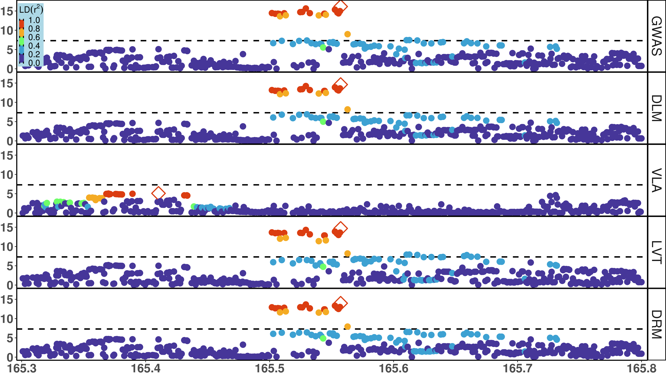
Notes:
Figure 3b: Local Manhattan Plot for T2D
x-axis: basepairs on chromosome 2; y-axis: -log₁₀(p); dash: significance threshold -log₁₀(5e-8); each point stands for a few dozen variants in a bin, represented by the most significant one.
Rows: 5 putative GxE test, GWAS = genome wide association study, DLM = double linear model, VLA = variance loci analysis (order-2 polynomial positive gradient test), LVT = Levene’s robust test, DRM = Deviation Regression Model; Color: denote LD between the top hit (diamond) and rest of the variants; red means high LD, blue means low LD.
Note for US:
binning of variants thin the number of points for a better presentation.
This local plot present the region marked by red circles in the full plot (the thumbnail to the right, or previous page); the thumbnail is optional.
The top hit for VLA is different (to the left) from the other 4 tests (in the middle, around rs6712203).

Slide 7
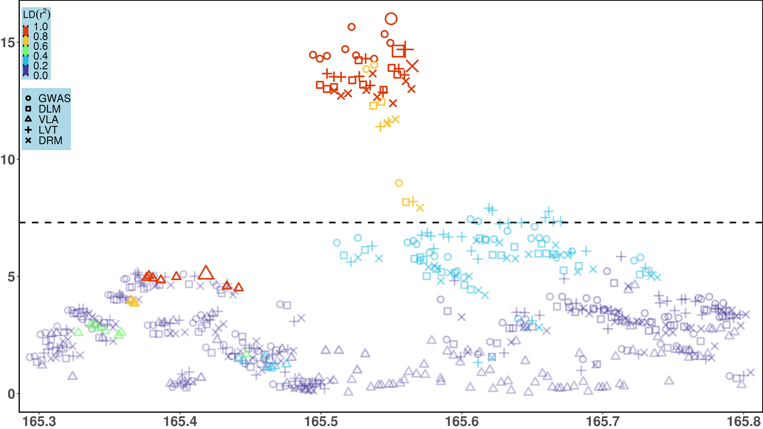
Notes:
Figure 3b: Local Manhattan plot for T2D, on region 2:165.1 – 165.9Mbp
x-axis: basepairs on chromosome 2; y-axis: -log₁₀(p); a point stands for a few dozen variants in a bin, represented by the most significant one in it; dashed line: significance threshold -log₁₀(5e-8), enlarged points denote the most significant hit for each test; shapes: 5 putative GxE test, GWAS (circle) = genome wide association study, DLM (square) = double linear model, VLA (triangle) = variance loci analysis (order-2 polynomial positive gradient test), LVT (cross) = Levene’s robust test, DRM (check mark) = Deviation Regression Model; Color: denote LD between the top hit (larger point) and rest of the variants WITHIN each test; red means highest LD, purple means lowest LD.
Note for US:
This is a super-imposed version of previous plot (page 6); Bin the variants to thin the number of points in the plot, so the presentation is cleaner.
The top hit for VLA is different (to the left around 165.42Mb) from the other 4 tests (in the middle, around rs6712203, near 165.55Mb).
This local Manhattan plot present the region surrounding rs6712203, marked by red circles in the full plot (see page 5). The Thumbnail is optional.

Slide 8
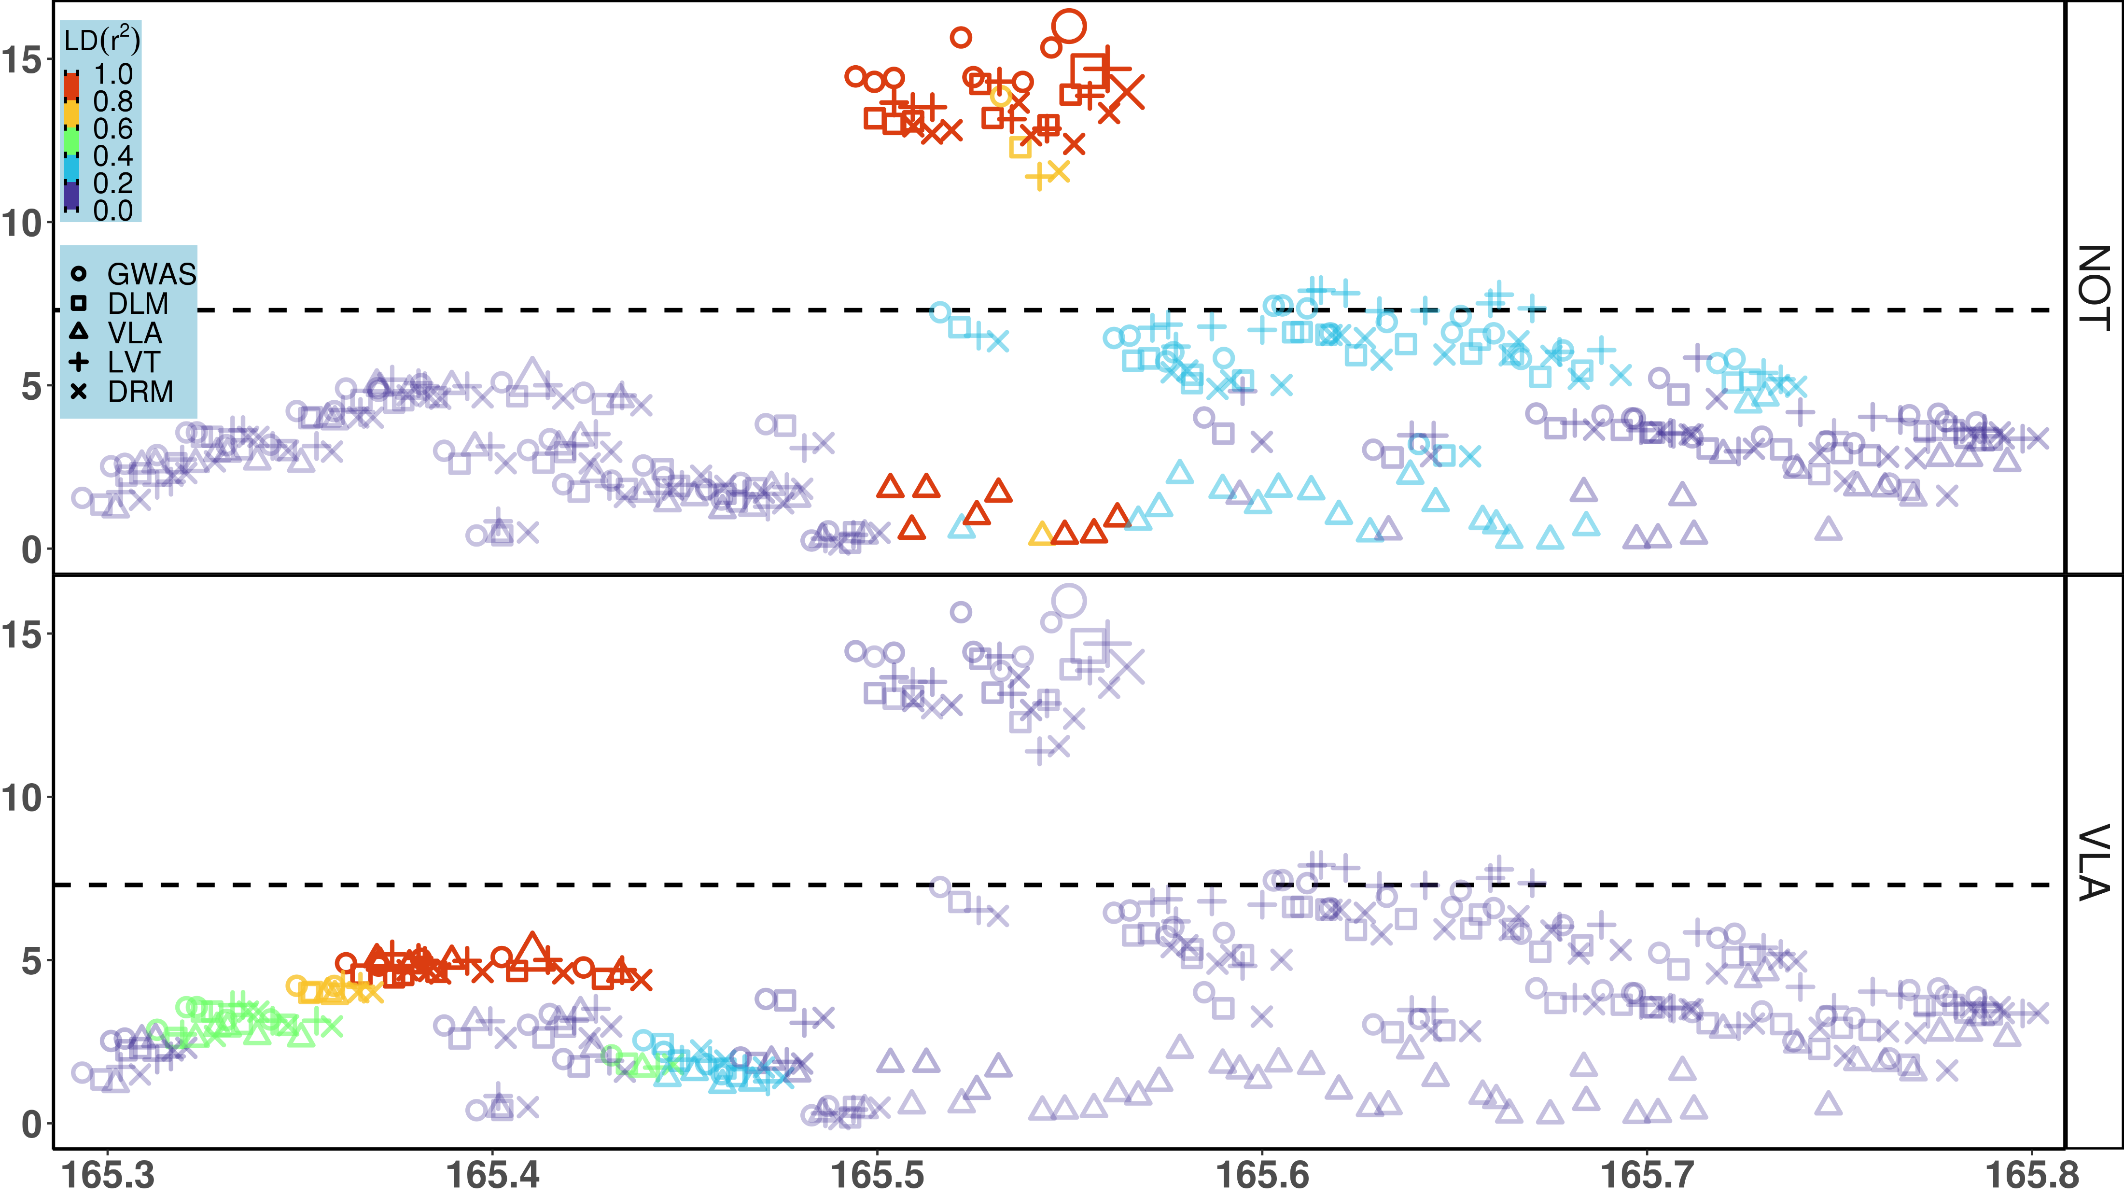
Notes:
Figure 3b: Local Manhattan plot for T2D, on region 2:165.1 – 165.9Mbp
x-axis: basepairs on chromosome 2; y-axis: -log₁₀(p); a point stands for a few dozen variants in a bin, represented by the most significant one in it; dashed line: significance threshold -log₁₀(5e-8), enlarged points denote the most significant hit for each test; shapes: 5 putative GxE test, GWAS (circle) = genome wide association study, DLM (square) = double linear model, VLA (triangle) = variance loci analysis (order-2 polynomial positive gradient test), LVT (cross) = Levene’s robust test, DRM (check mark) = Deviation Regression Model; Color: denote LD between the top hit (larger point) and rest of the variants for ALL test, where red means highest LD, purple means lowest LD; the top plot present LD relative to rs6712203, the top hits of non-VLA test (i.e., GWAS, DLM, LVT, and DRM) concentrated near165.55Mb; the bottom plot present LD relative to the top hit of VLA near 165.42MB.
Note for US:
This is a super-imposed version of previous plot (page 6); Bin the variants to thin the number of points in the plot, so the presentation is cleaner.
The top hit for VLA is different (to the left around 165.42Mb) from the other 4 tests (in the middle, around rs6712203, near 165.55Mb).
This local Manhattan plot present the region surrounding rs6712203, marked by red circles in the full plot (see page 5). The Thumbnail is optional.

Slide 9
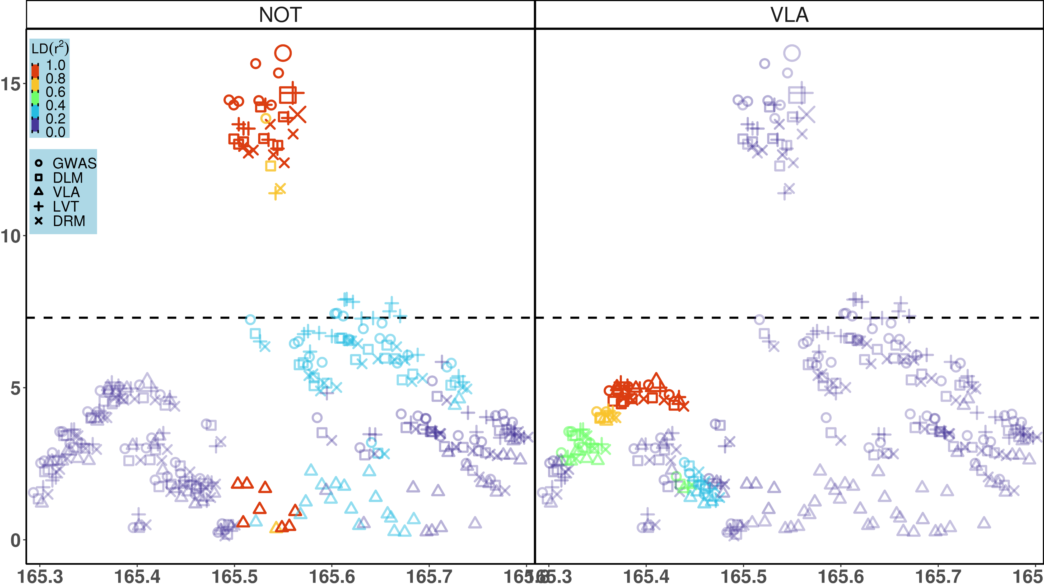
Notes:
Figure 3b: Local Manhattan plot for T2D, on region 2:165.1 – 165.9Mbp
x-axis: basepairs on chromosome 2; y-axis: -log₁₀(p); a point stands for a few dozen variants in a bin, represented by the most significant one in it; dashed line: significance threshold -log₁₀(5e-8), enlarged points denote the most significant hit for each test; shapes: 5 putative GxE test, GWAS (circle) = genome wide association study, DLM (square) = double linear model, VLA (triangle) = variance loci analysis (order-2 polynomial positive gradient test), LVT (cross) = Levene’s robust test, DRM (check mark) = Deviation Regression Model; Color: denote LD between the top hit (larger point) and rest of the variants for ALL test, where red means highest LD, purple means lowest LD; the left plot present LD relative to rs6712203, the top hits of non-VLA tests (i.e., GWAS, DLM, LVT, and DRM) near165.55Mb; the right plot present LD relative to the top hit of VLA near 165.42MB.
Note for US:
This is a super-imposed version of previous plot (page 6); Bin the variants to thin the number of points in the plot, so the presentation is cleaner.
The top hit for VLA is different (to the left around 165.42Mb) from the other 4 tests (in the middle, around rs6712203, near 165.55Mb).
This local Manhattan plot present the region surrounding rs6712203, marked by red circles in the full plot (see page 5). The Thumbnail is optional.

Slide 10
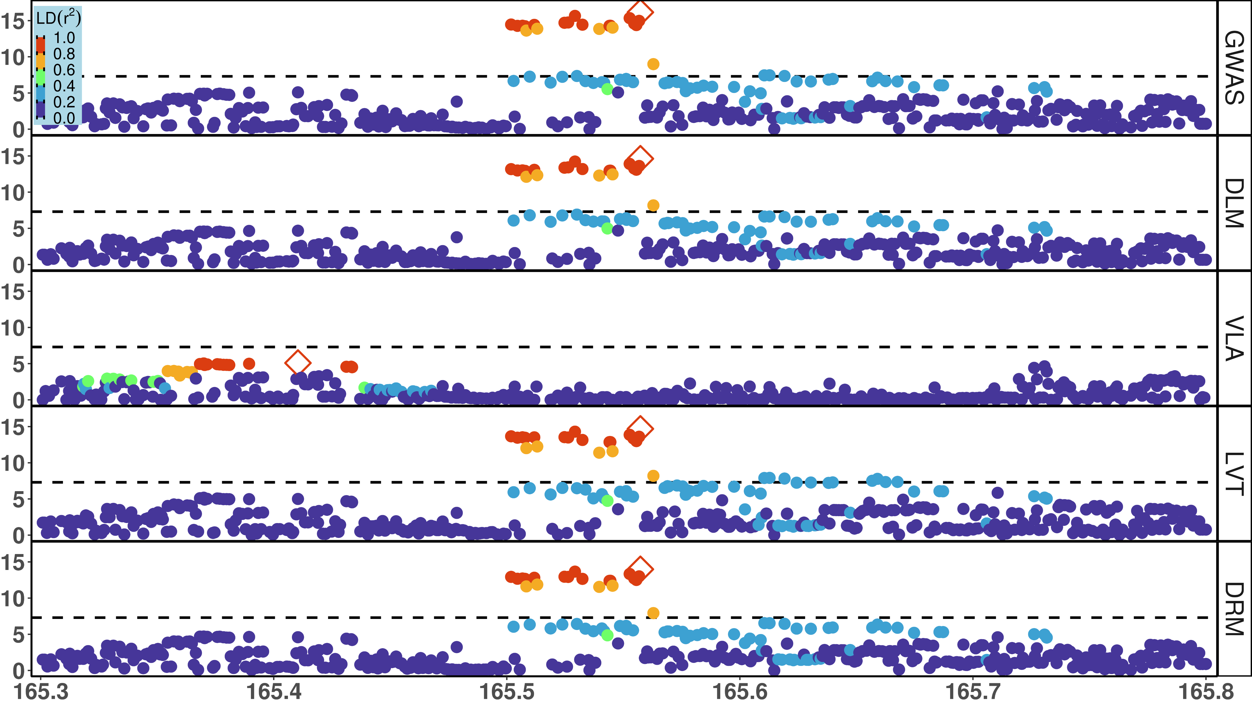



Notes:
All 4 layouts put together.

Slide 11
